Slide 1


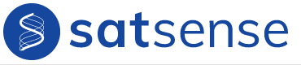
Incorporating Short Term Transients Into VLM and RSLR Projections: an Example from Aotearoa/new Zealand
Ian Hamling, Richard Levy, Tim Naish and Sigrun Hreinsdottir

Slide 2
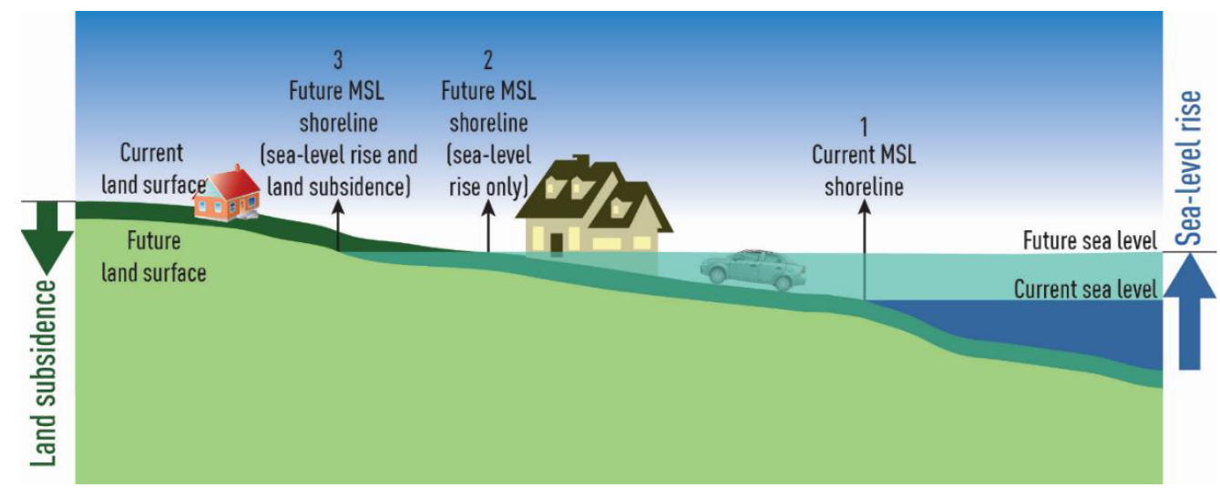
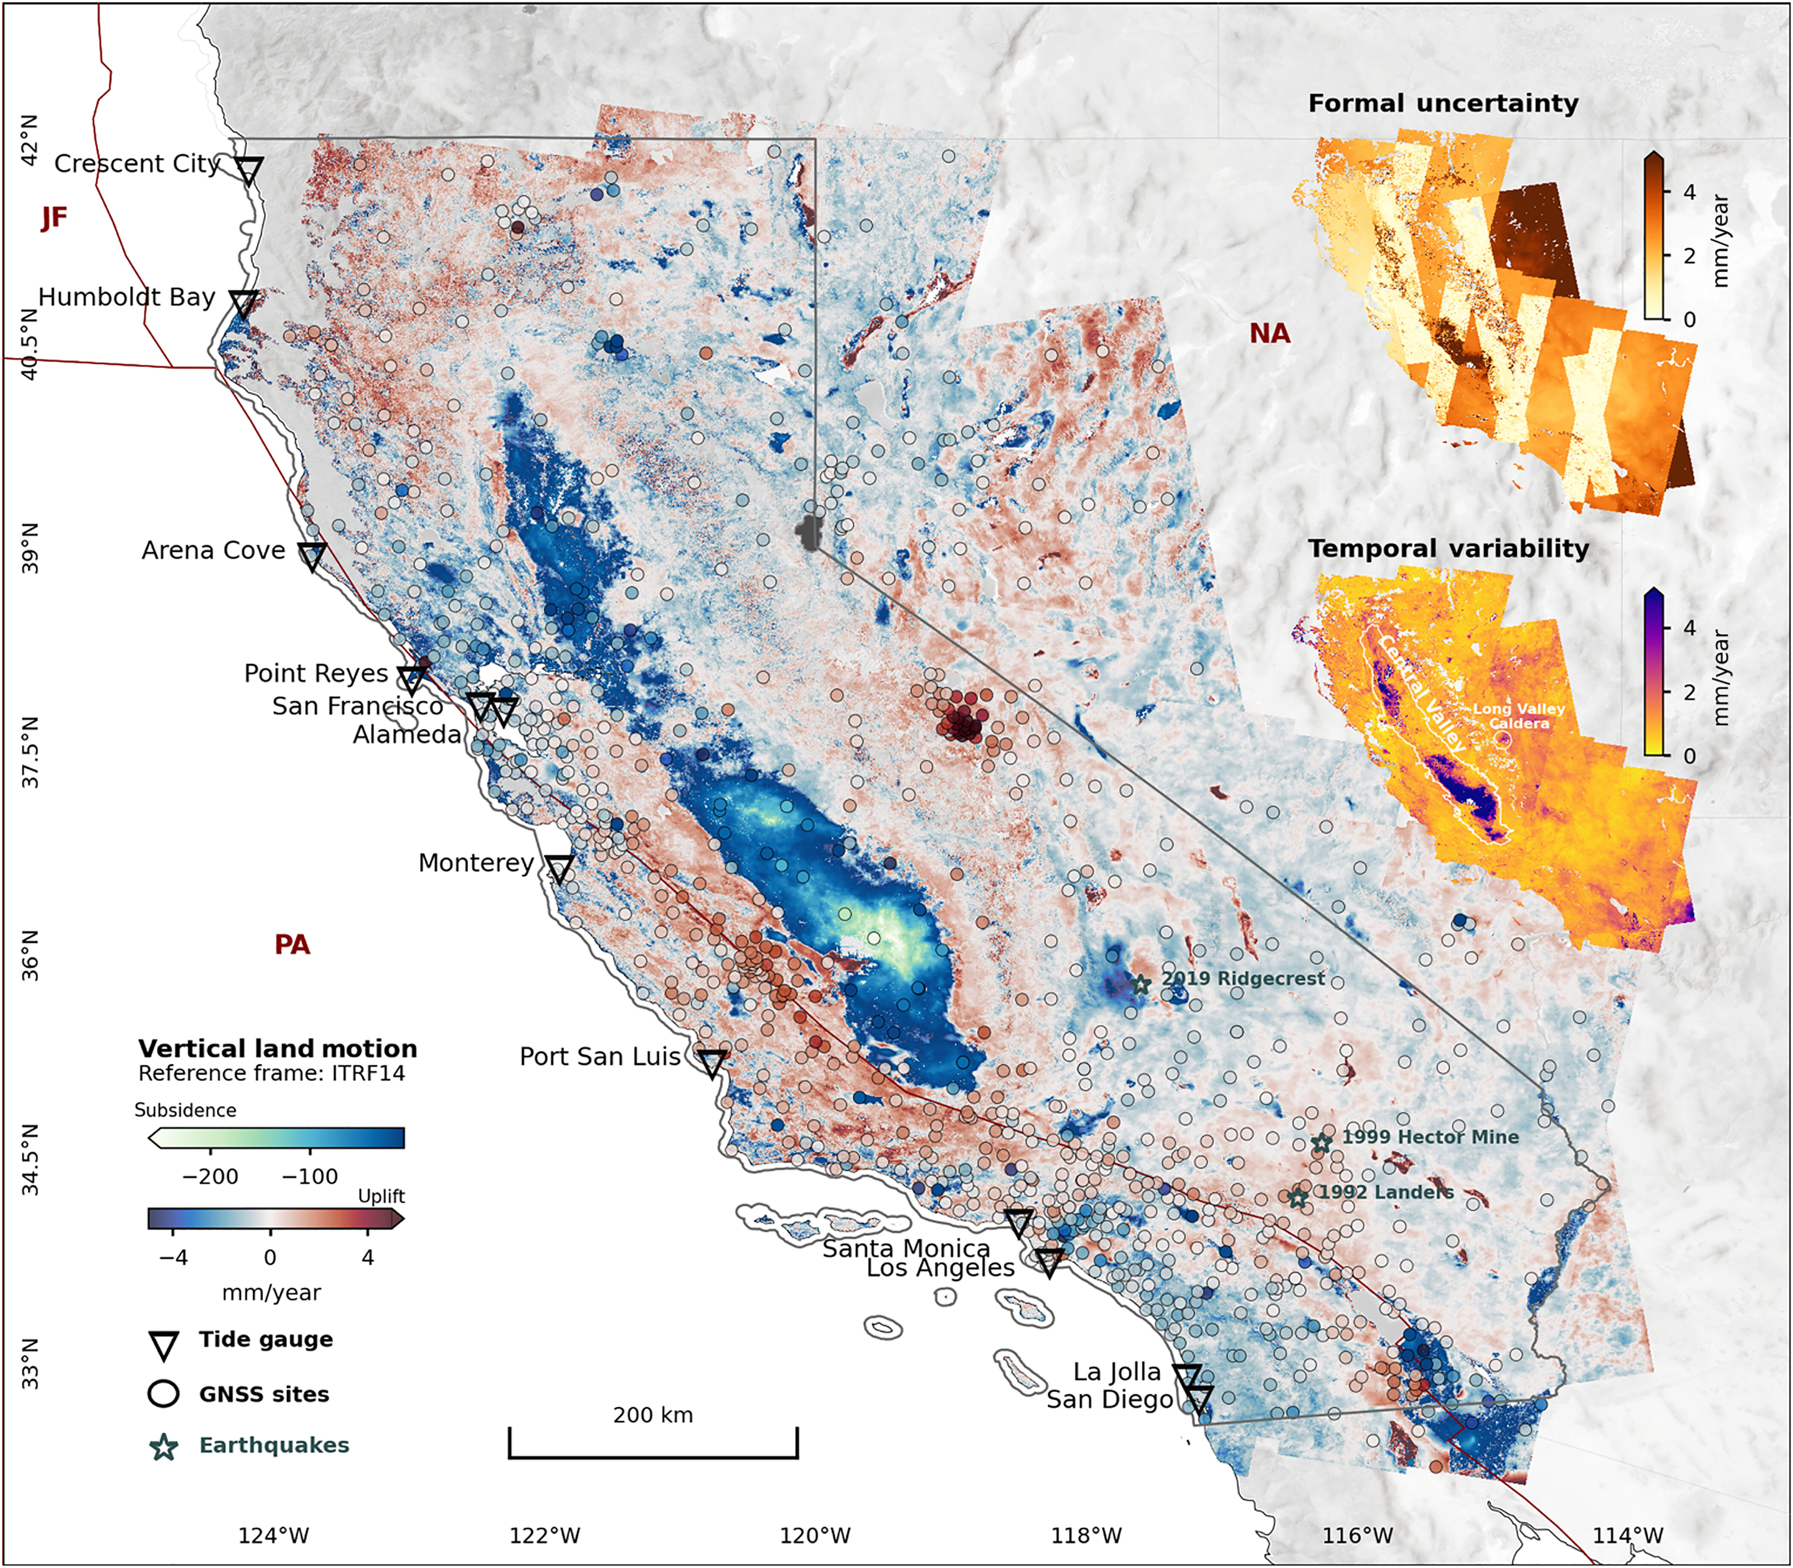
Vertical Land Movement (VLM) Matters!
Now a growing consensus that VLM is a key component to estimating RSLR.
Between 2014 and 2026, there has been a ~1,200% increase in annual publications focusing on InSAR-derived VLM for sea-level rise applications.
However, variations in both space and time make it challenging to incorporate into porjections.
Short-term transients from human activities, tectonics, or volcanism can affect VLM rates, questioning the validity of short-term estimates.
While a number of studies have highlighted the issue, limited progress has been made on better projecting VLM beyond using linear rates
Govorcin et al., 2025

Slide 3
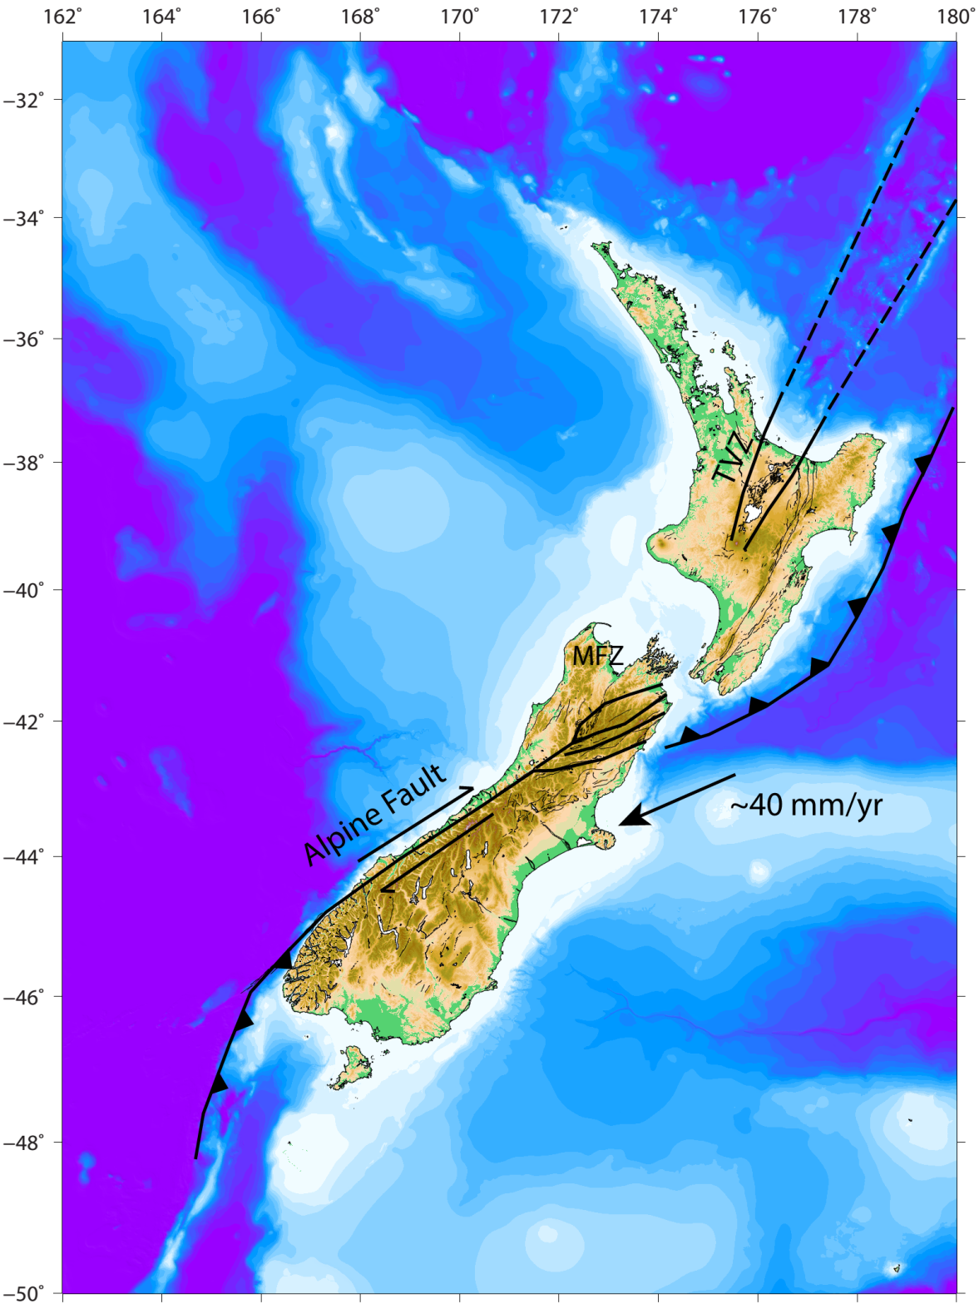
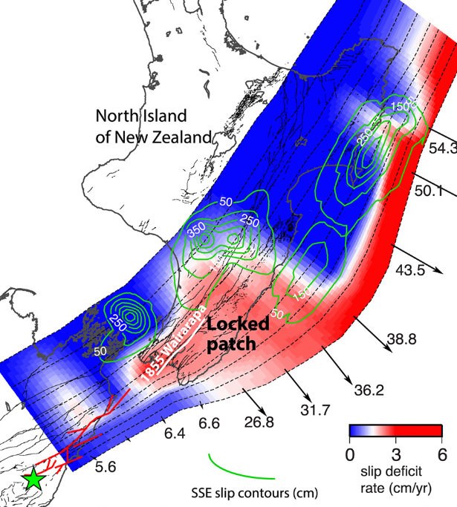

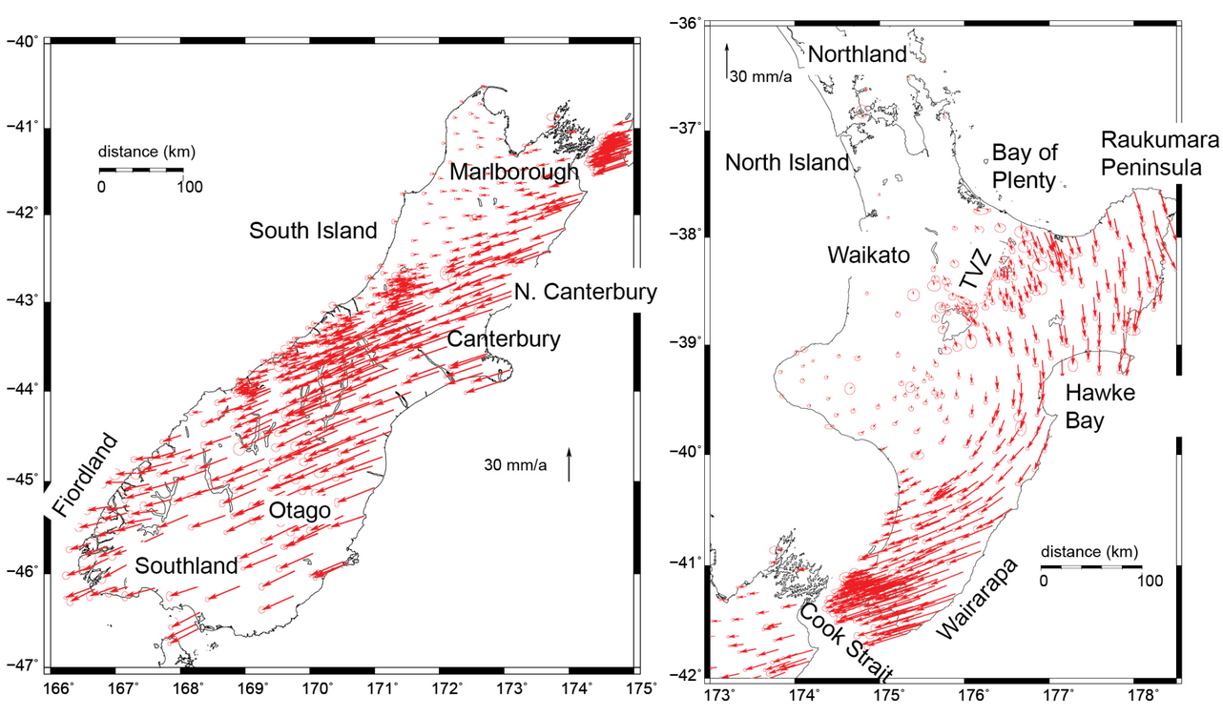


Tectonics of Aotearoa New Zealand
Tectonics of New Zealand
The component of motion normal to the boundary is accommodated along the Hikurangi subduction zone and faults in the overriding plate.
The margin parallel component of plate motion in central New Zealand occurs via a combination of rotation (∼10 mm/yr) and strike-slip faulting in the upper plate (∼20 mm/yr)
Beavan et al., 2016
Wallace et al., 2016; Kaneko et al., 2018

Slide 4
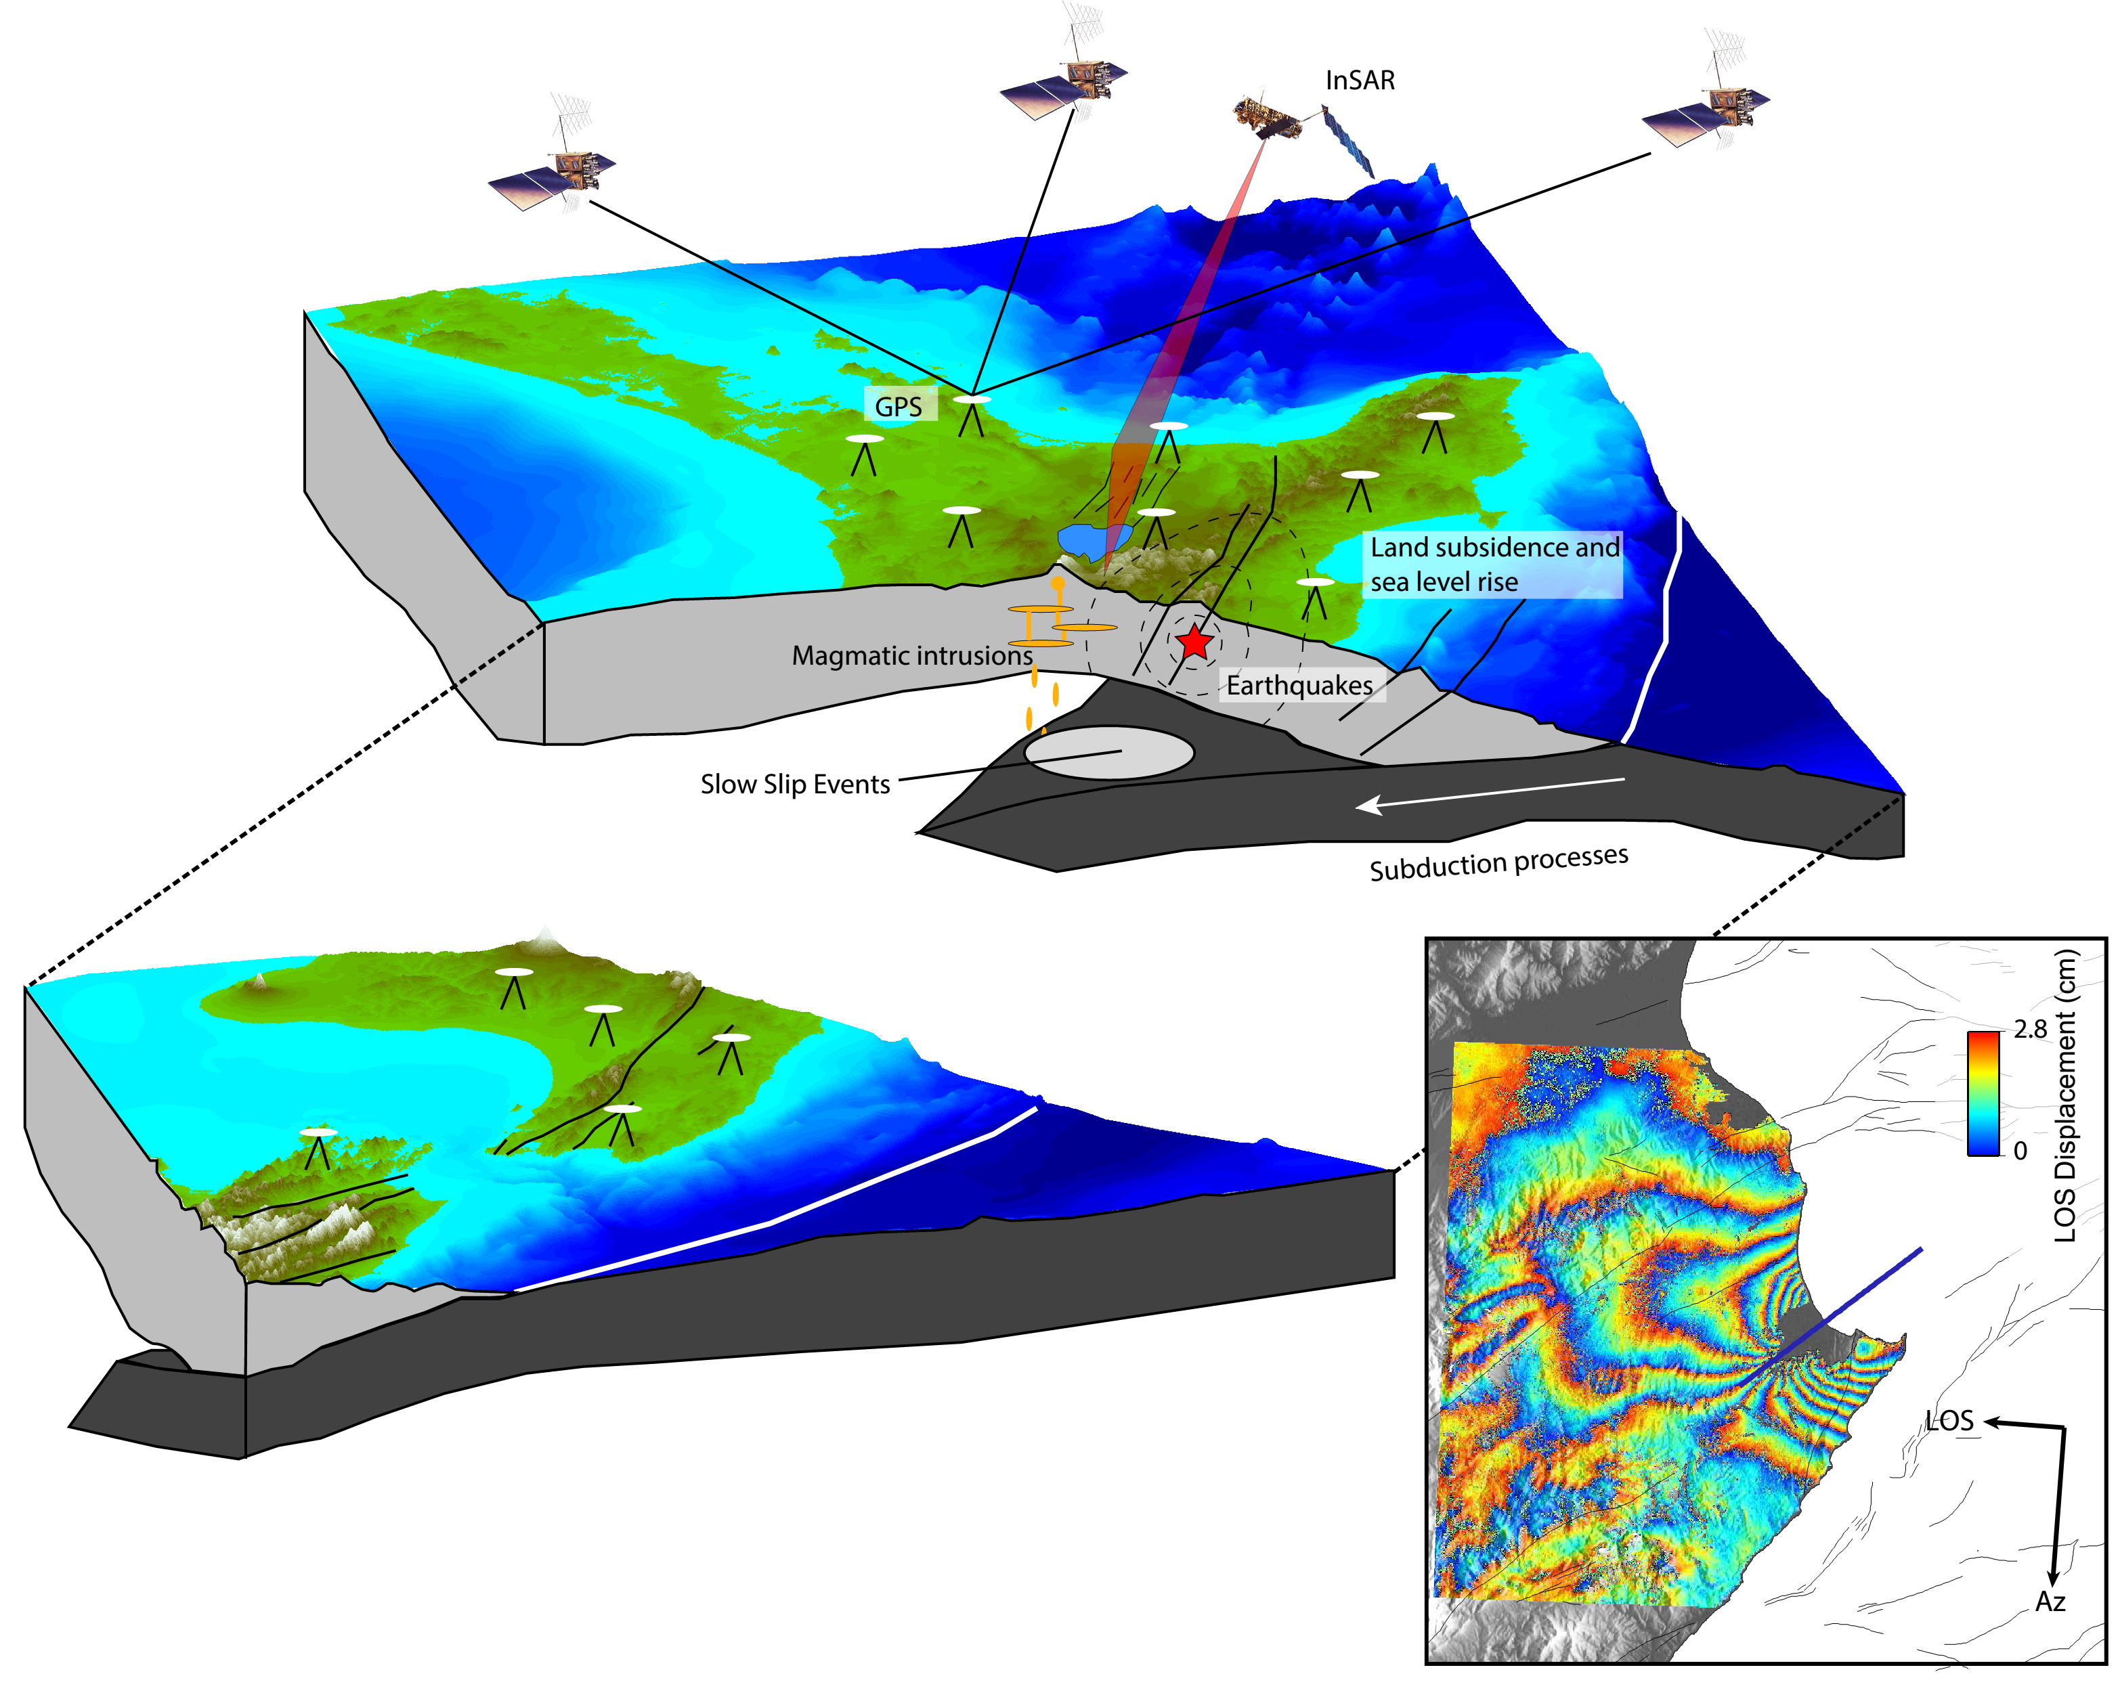
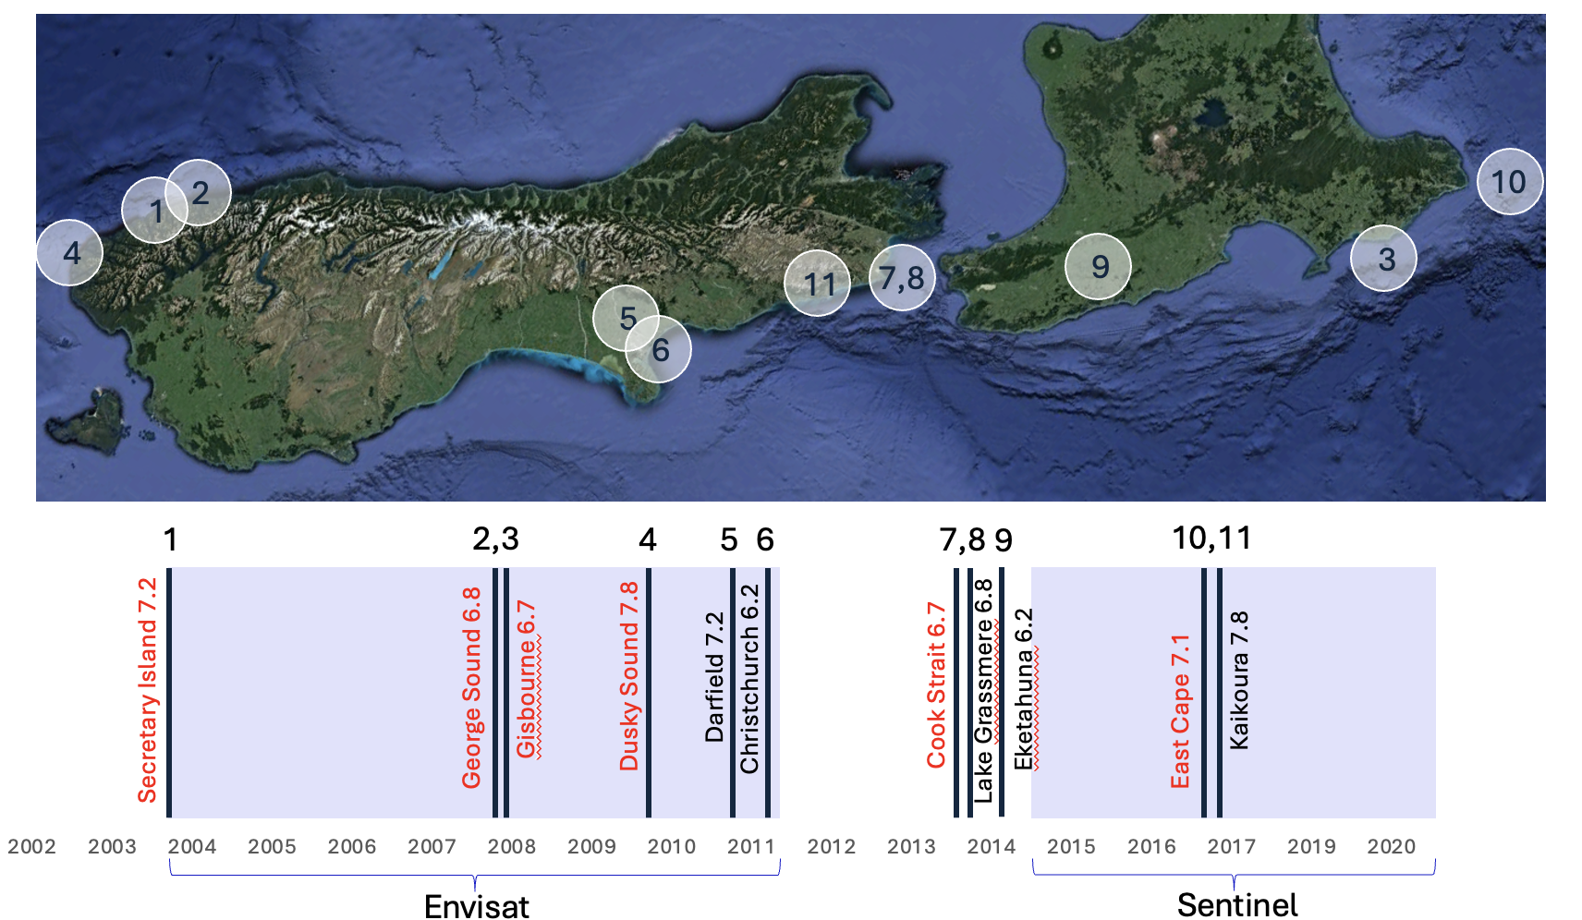
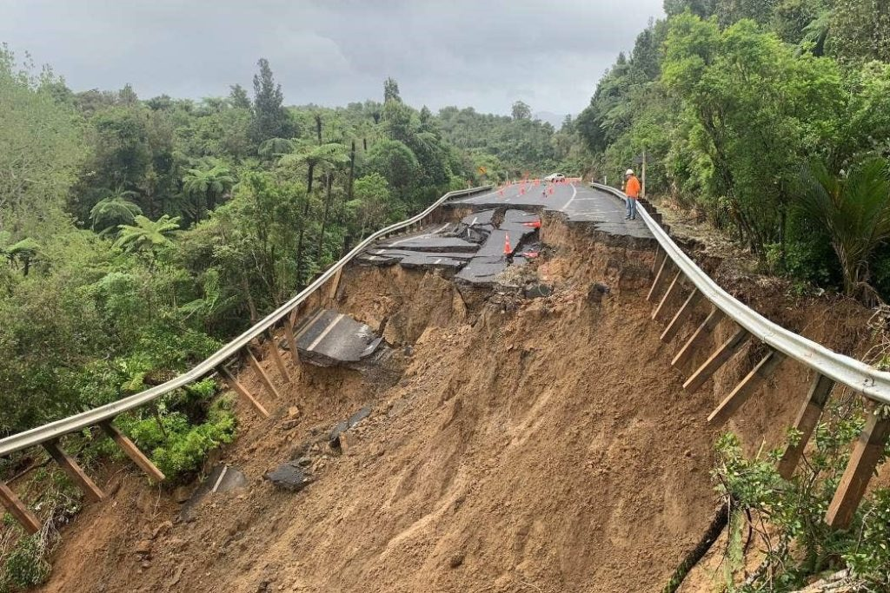
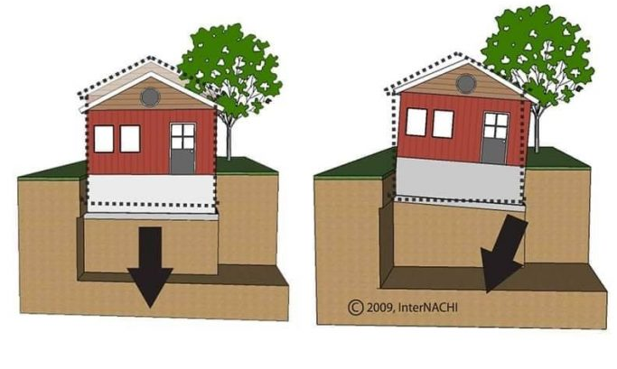
Tectonics of Aotearoa New Zealand
At present, ~35% of the New Zealand coast has been effected by earthquakes (co and post-seismic deformation)
Repeated SSE events also lead to a time-varying component of deformation
Many urban environments are witnessing heighted rates of subsidence from building loading and anthropogenic changes.
Landslides, infrastructure settlement, soil compaction

Slide 5
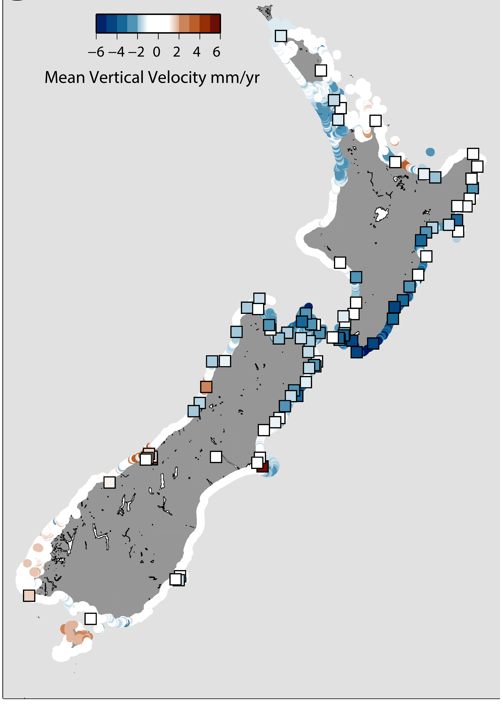
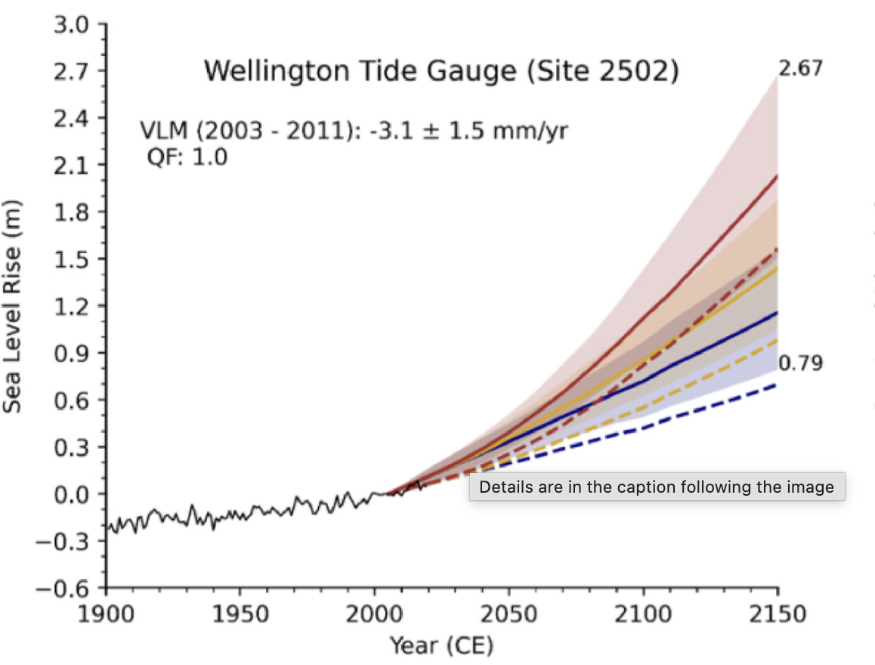
Previous VLM estimates across New Zealand
In New Zealand, current projections have used SSP scenarios combined with interseismic VLM estimates derived from Envisat at 2-km intervals.
However, recent earthquakes and post-seismic transients, especially after the 2016 Mw 7.8 Kaikoura earthquake make their projection into the future unreliable.
Here we combine Envisat interseismic VLM estimates with a new Sentinel-1 dataset from 2017 to 2026.
These projections include co-seismic VLM from earthquakes since 2005 and a method to account for post-seismic transients and urban loading affecting VLM rates in the short to medium term.
Naish et al., 2024

Slide 6
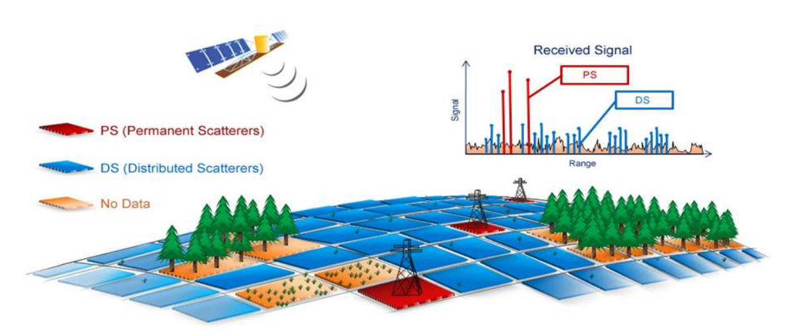
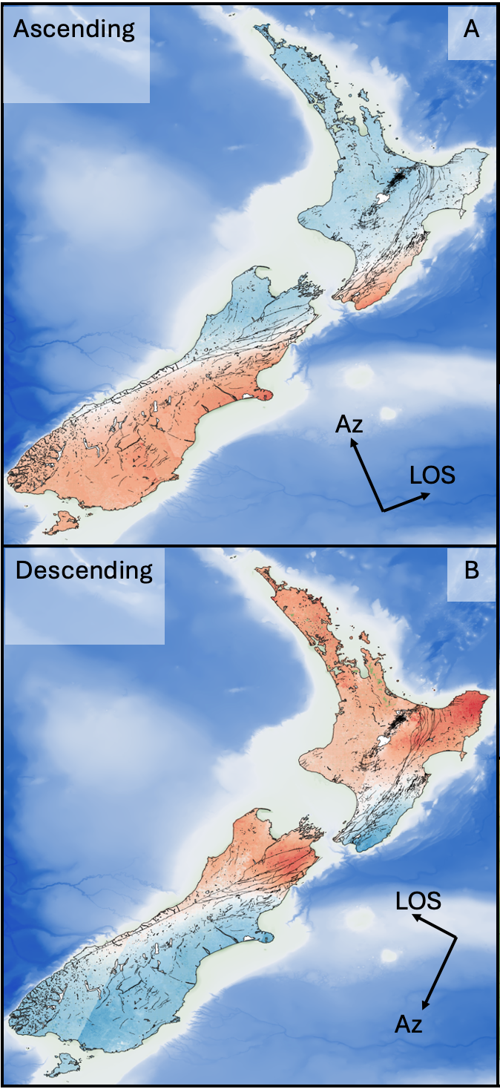
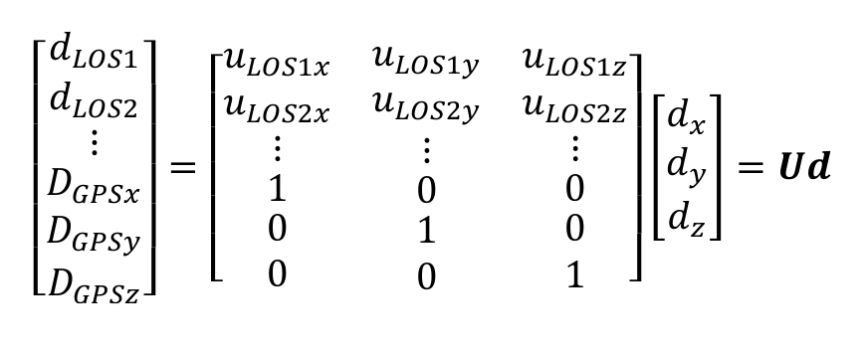
Sentinel-1 observations
New VLM dataset is derived using data from Sentiel-1A/B/C SAR between January 2017 and January 2026 using a modified SqueeSAR/RapidSAR (processed by SatSense Ltd) processing chain to maximise spatial coverage.
We use GNSS timeseries data from the national GeoNet network to pin the InSAR into a consistent reference frame (ITRF20)
Use all the InSAR plus interpolated GNSS to solve for the east, north and up components of the deformation field

Slide 7
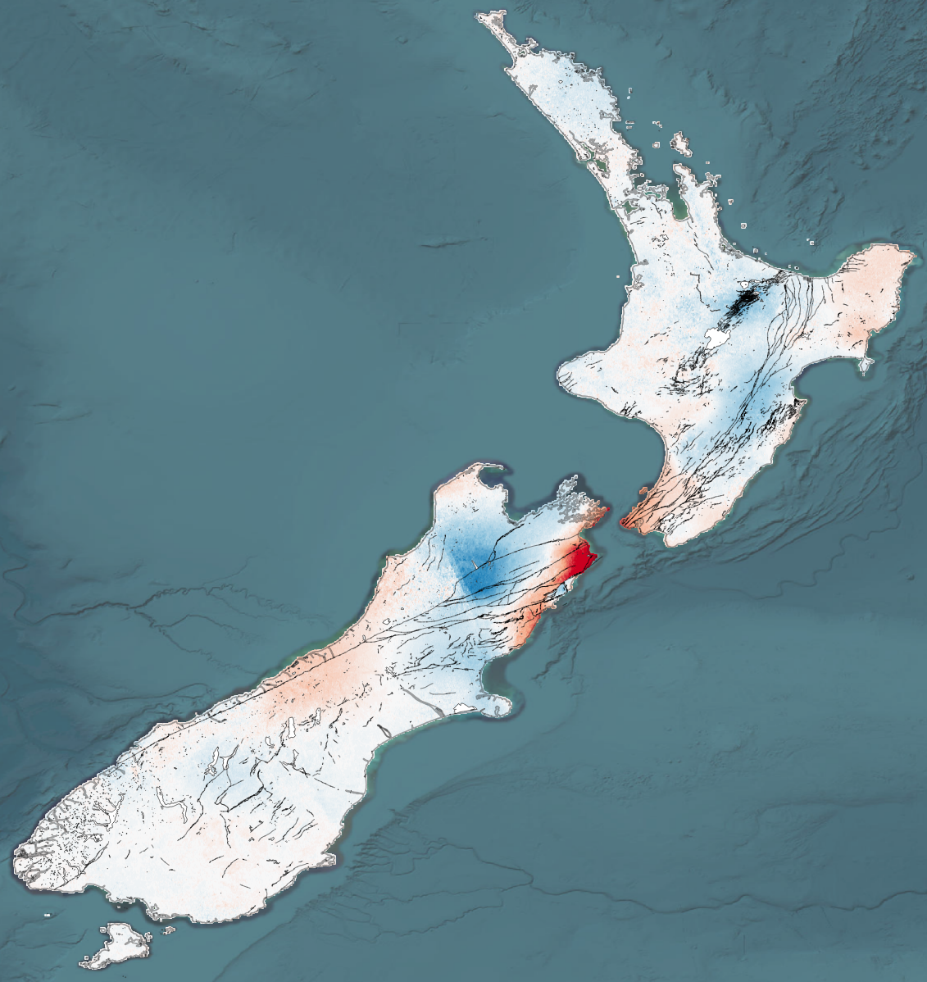
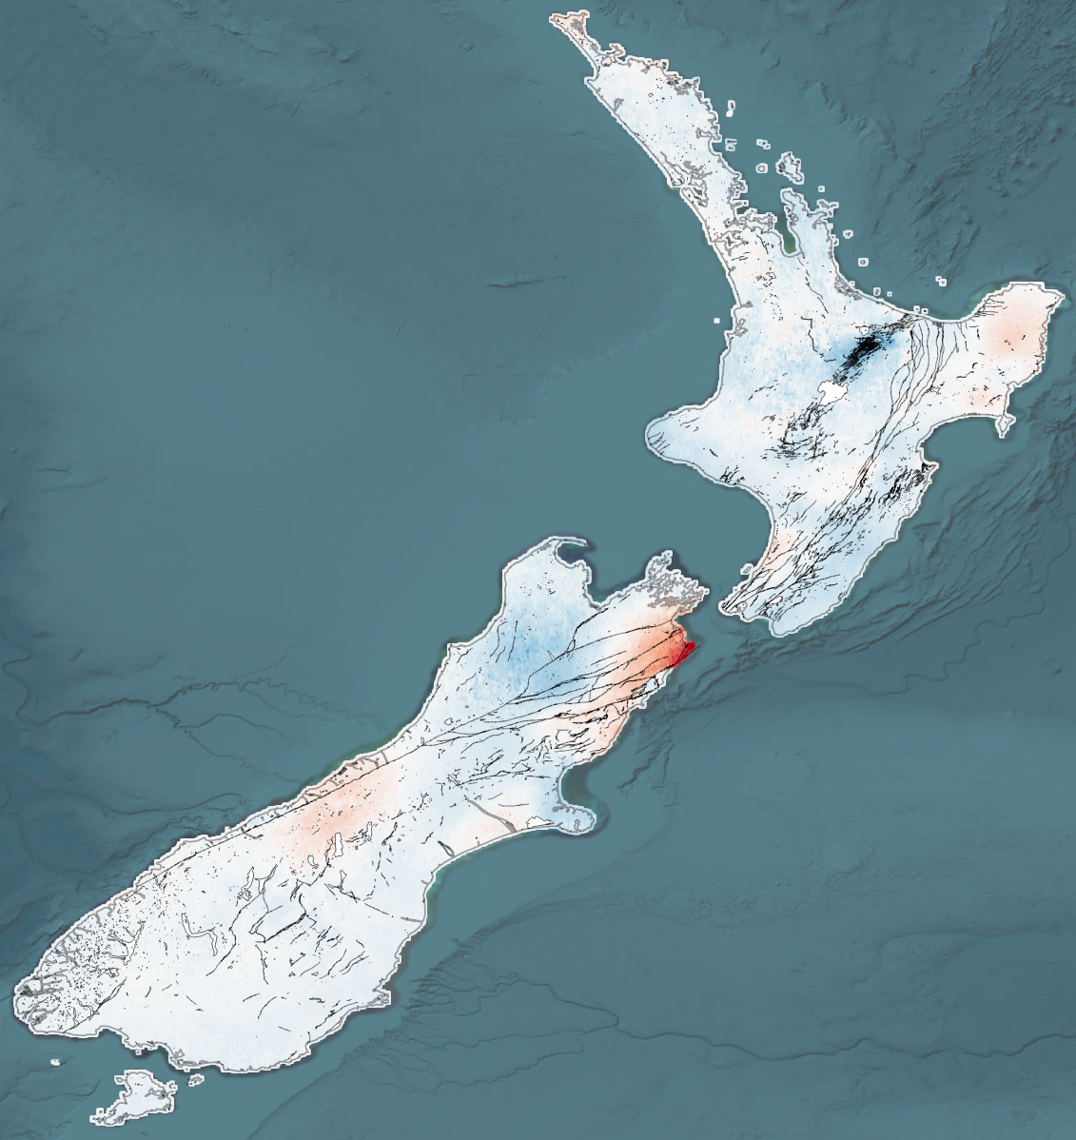
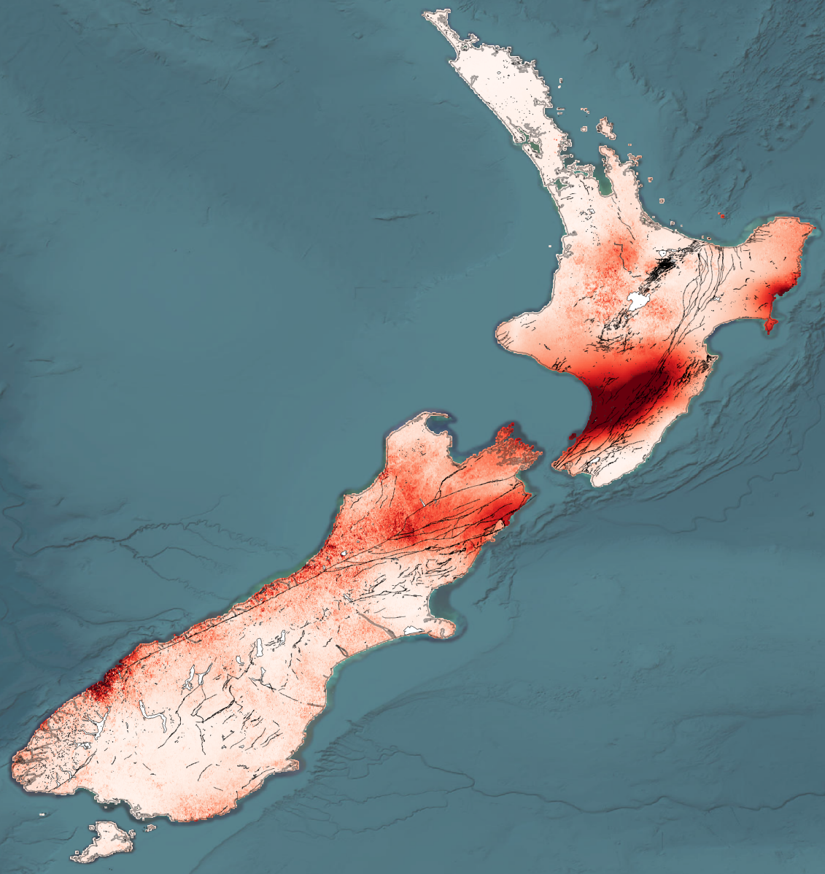
Sentinel-1 observations
To estimate the velocities, we identify and isolate early post-seismic deformation around Kaikoura and other significant transients using a Fourier analysis and solve for the best fitting velocities from January 2017 to April 2018, April 2018 to April 2019 and April 2019 to January 2026.
As well as the formal uncertainty, we estimate the rate using 2, 3 and 5-years of data on a moving 30-day window and calculate the Median absolute Deviation to give measure of temporal stability (Govorcin et al., 2025)
Sites that are stable in time will have a low value
-30
0
30
-18
0
18
0
12
Vertical Velocity (mm/yr)
Vertical Velocity (mm/yr)
Vertical Error (mm/yr)
January 2017 – April 2018
April 2019 – January 2026

Slide 8
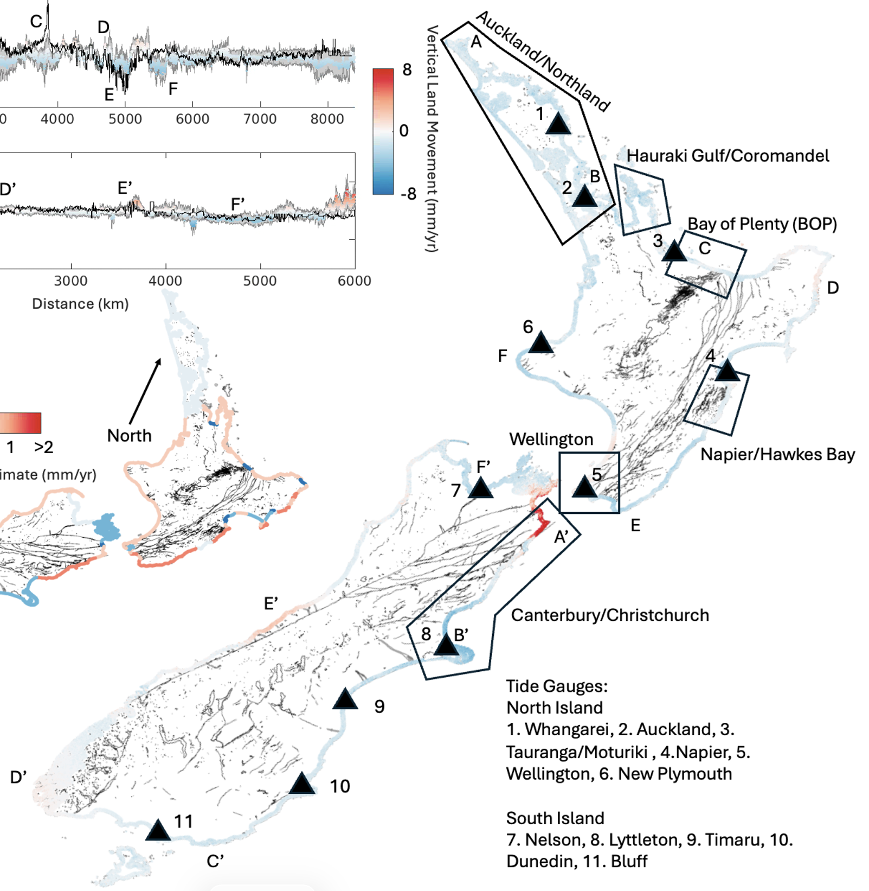
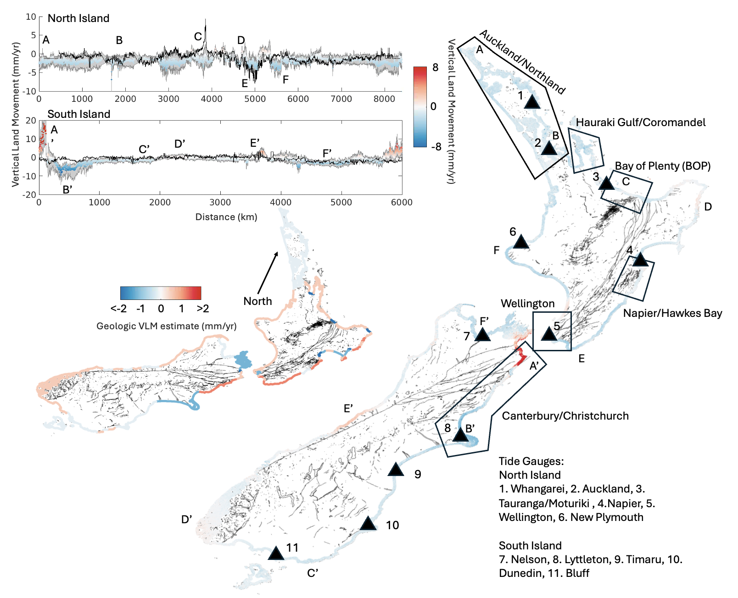
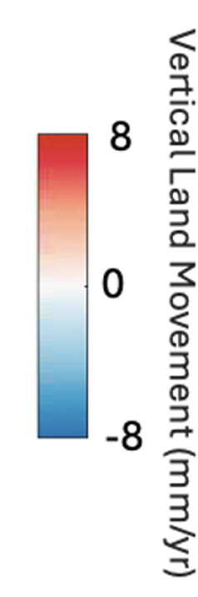

Slide 10
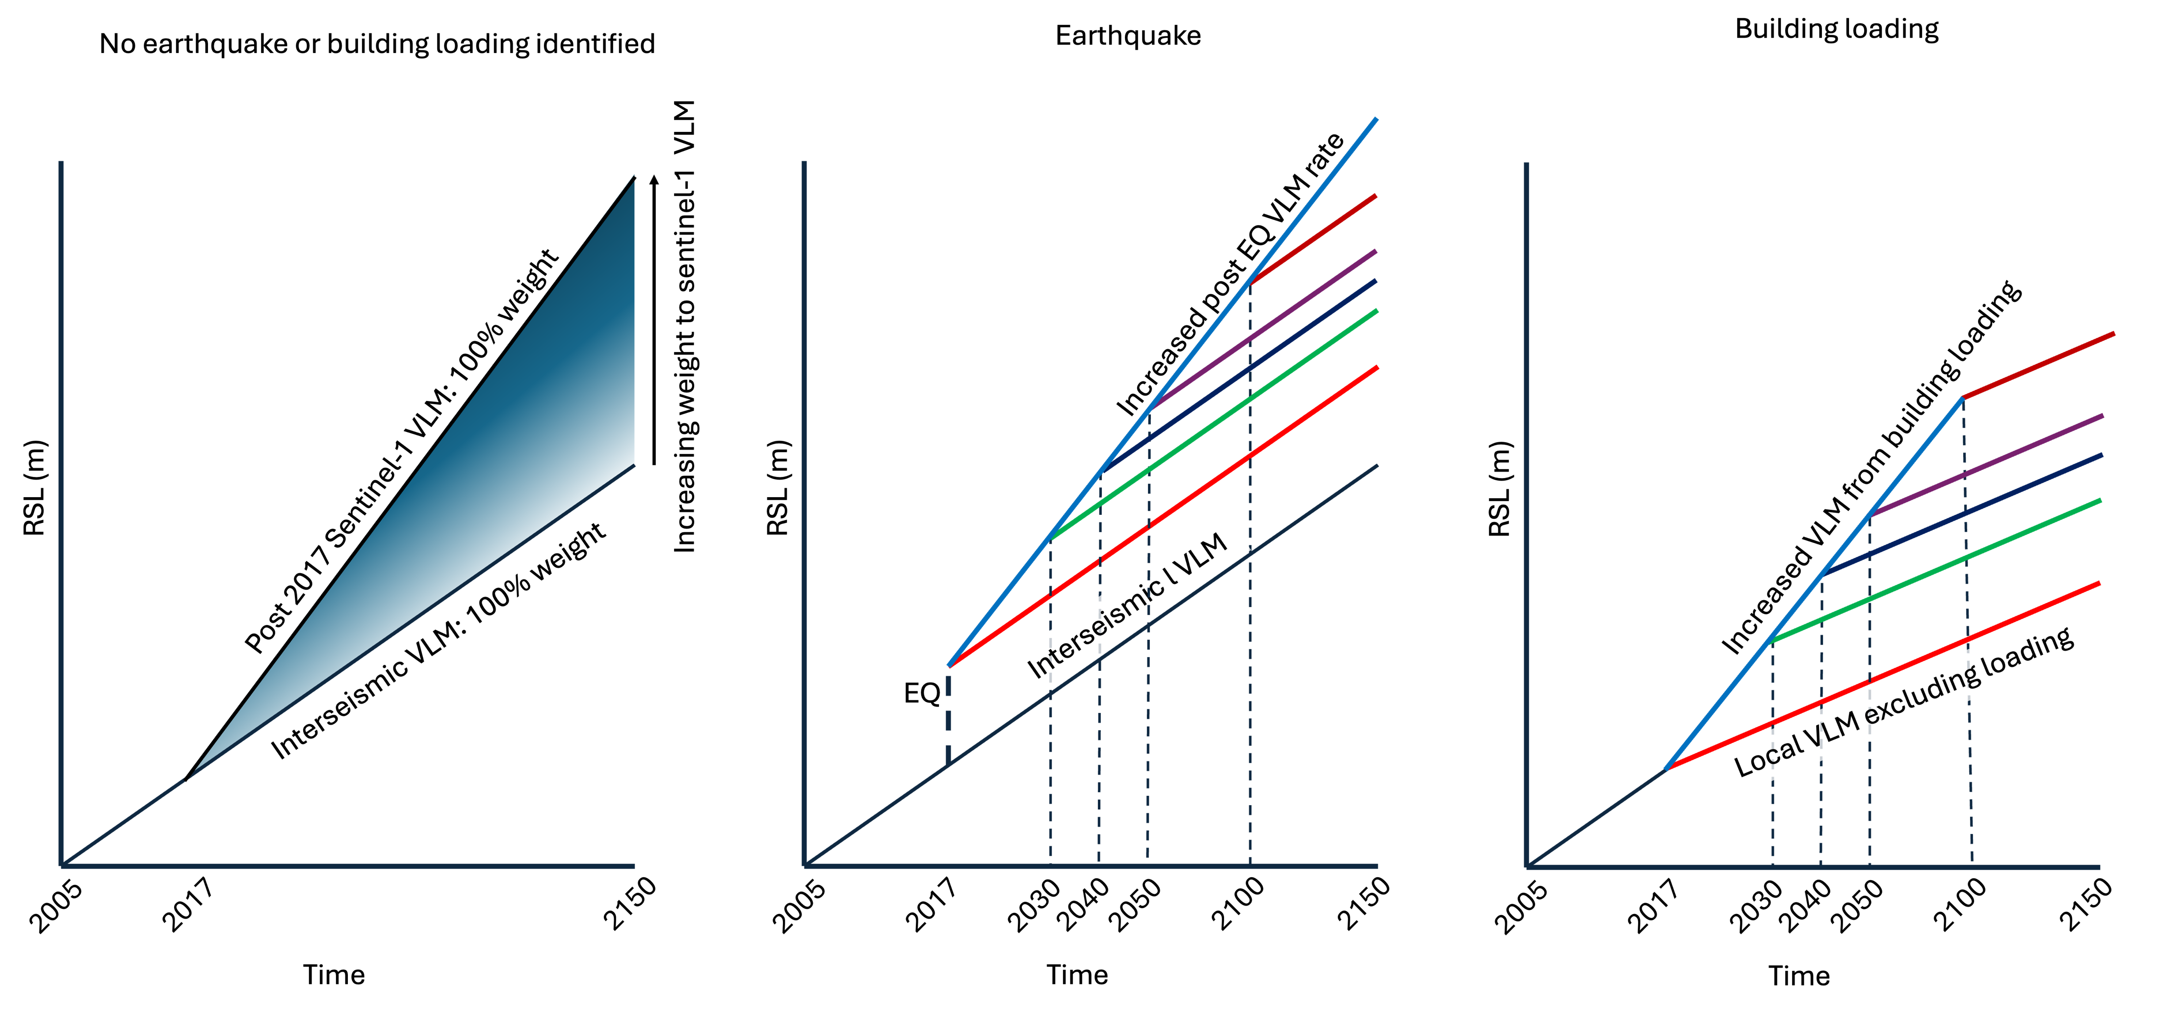
VLM rate estimates: Fusing interseismic rates with current rates, EQ offsets, post-seismic and building loading

Slide 11
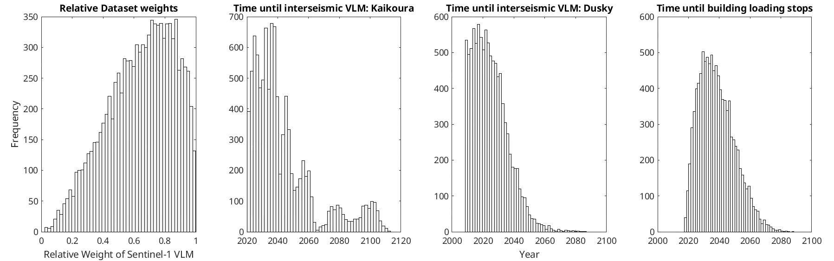
VLM rate estimates: Fusing interseismic rates with current rates, EQ offsets, post-seismic and building loading
To merge the Sentinel and Envisat datasets, an ensemble of 10,000 VLM realisations is generated using Monte Carlo sampling, with uncertainties propagated and adjusted for phase bias.
A weighted average of Sentinel-1 and Envisat VLM rate estimates is used to combine datasets, with a modal weight of 0.8 for Sentinel-1 and 0.2 for Envisat, or 0.5 for points potentially affected by phase bias.

Slide 12
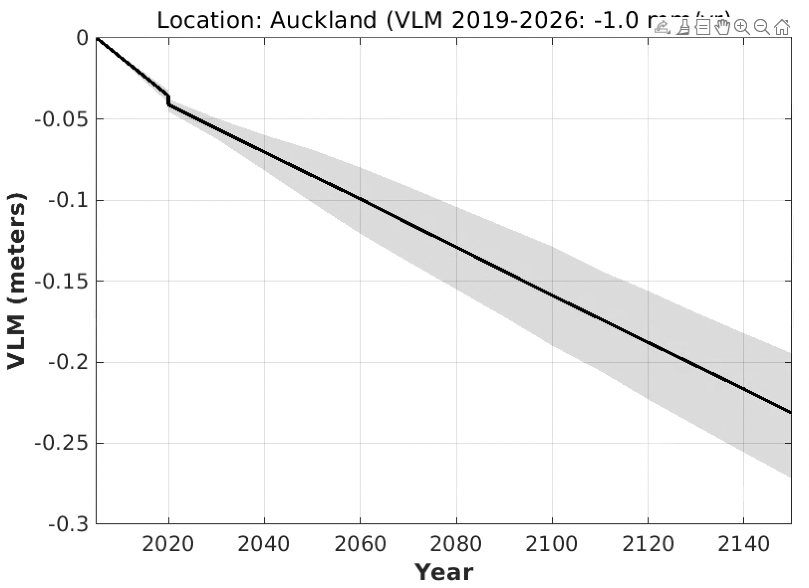
VLM rate estimates: Fusing interseismic rates with current rates, EQ offsets, post-seismic and building loading
To merge the Sentinel and Envisat datasets, an ensemble of 10,000 VLM realisations is generated using Monte Carlo sampling, with uncertainties propagated and adjusted for phase bias.
A weighted average of Sentinel-1 and Envisat VLM rate estimates is used to combine datasets, with a modal weight of 0.8 for Sentinel-1 and 0.2 for Envisat, or 0.5 for points potentially affected by phase bias.
Sentinel-1 only
Envisat only

Slide 13
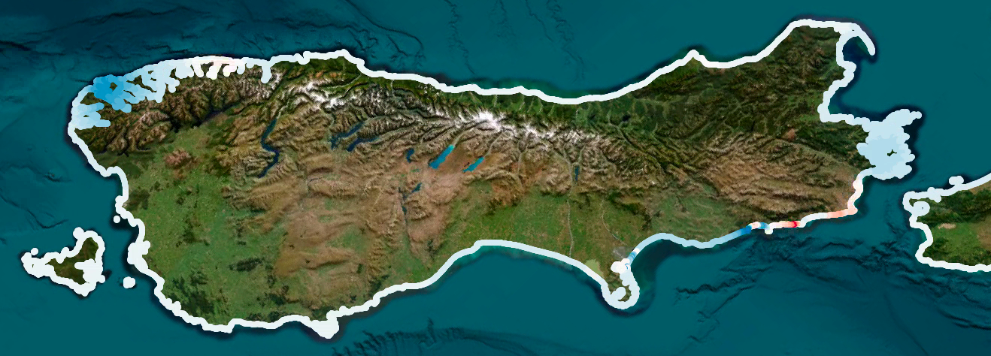
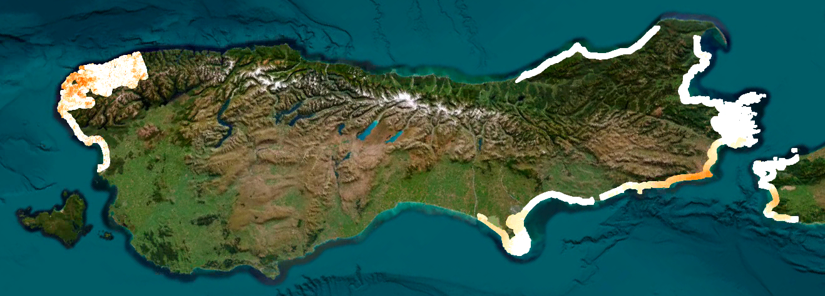
VLM rate estimates: Fusing interseismic rates with current rates, EQ offsets, post-seismic and building loading
Since 2005 (the start of the IPCC emission scenarios), ~35% of the New Zealand coastline has been impacted by moderate to large earthquakes, notably the 2009 Mw 7.8 Dusky Sound and 2016 Mw 7.8 Kaikoura earthquakes.
To address this, we use published EQ slip models to estimate co-seismic offsets which are added to the total VLM cumulative estimate.
Dusky Sound
-0.3
0
1.25
2.5
Kaikoura
Cape Campbell
Christchurch
Co-Seismic VLM (m)
2055
2085
2006
2025
Time to interseismic

Slide 14
VLM rate estimates: Fusing interseismic rates with current rates, EQ offsets, post-seismic and building loading
Since 2005 (the start of the IPCC emission scenarios), ~35% of the New Zealand coastline has been impacted by moderate to large earthquakes, notably the 2009 Mw 7.8 Dusky Sound and 2016 Mw 7.8 Kaikoura earthquakes.
To address this, we use published EQ slip models to estimate co-seismic offsets which are added to the total VLM cumulative estimate.
Post-seismic transients are accounted for by introducing a rate change in VLM projections using an Omori-like decay (Ingleby and Wright 2017), allowing for the estimation of when post-seismic rates will return to interseismic levels in areas around Kaikoura and Dusky

Slide 15
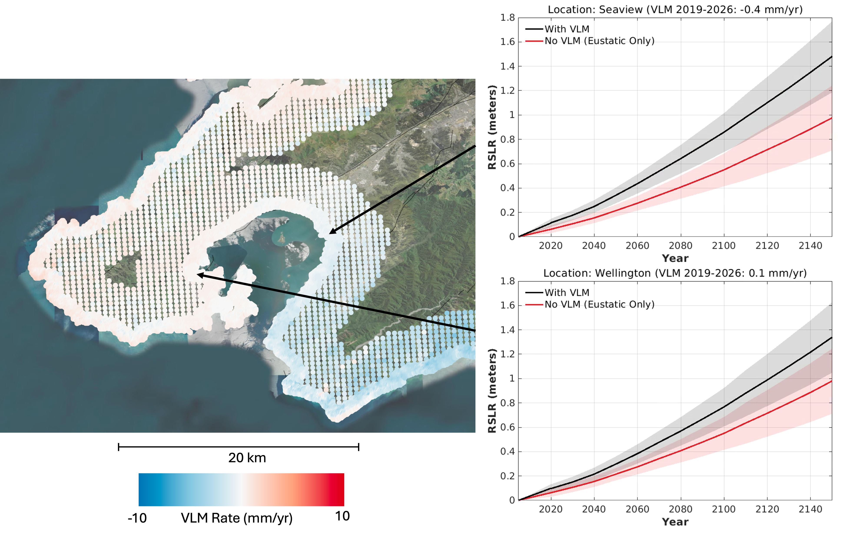
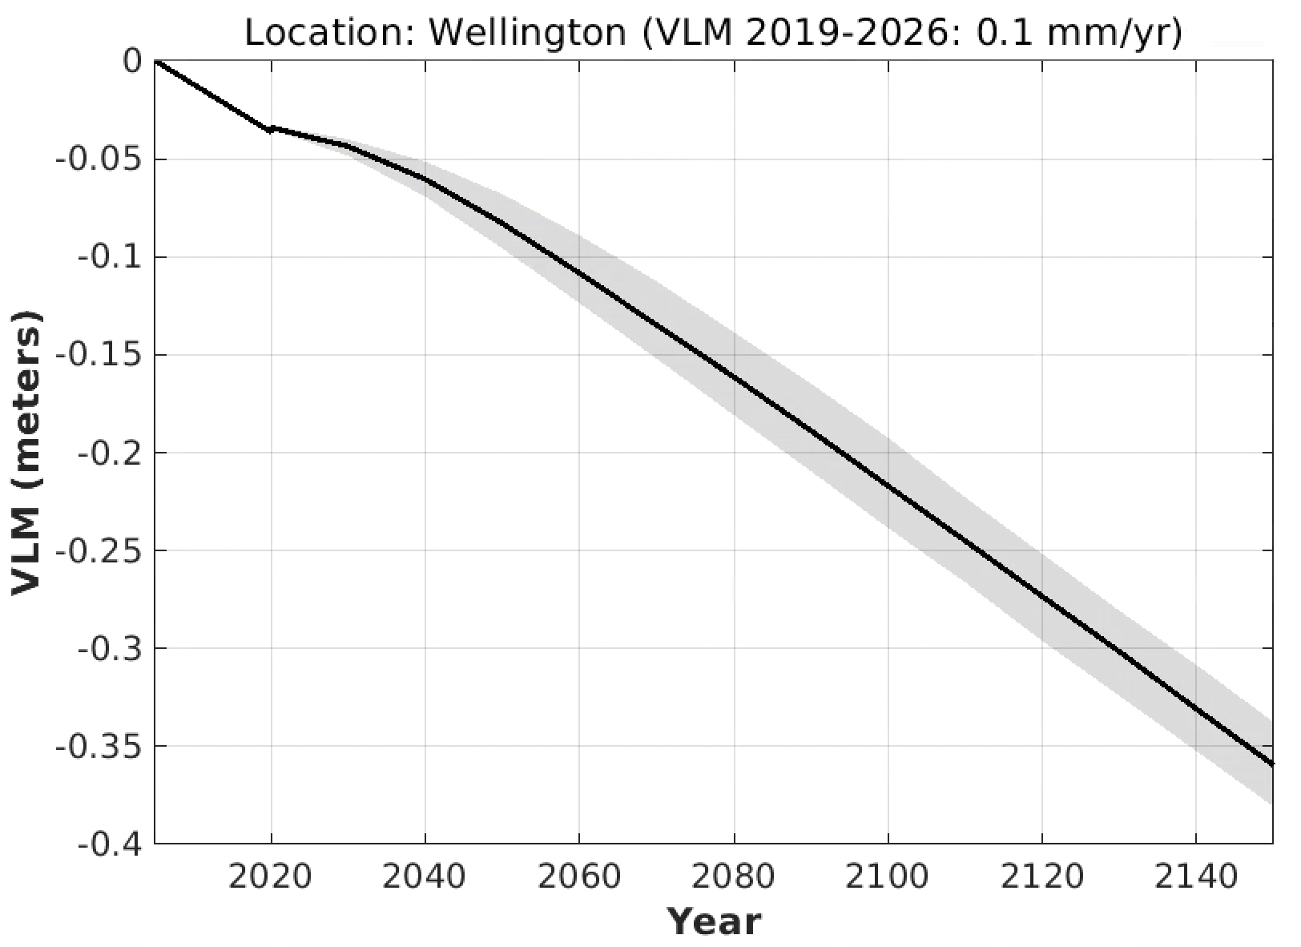
VLM rate estimates: Fusing interseismic rates with current rates, EQ offsets, post-seismic and building loading
In the case of Wellington current VLM rates are close to zero following the Kaikoura earthquake.

Slide 16
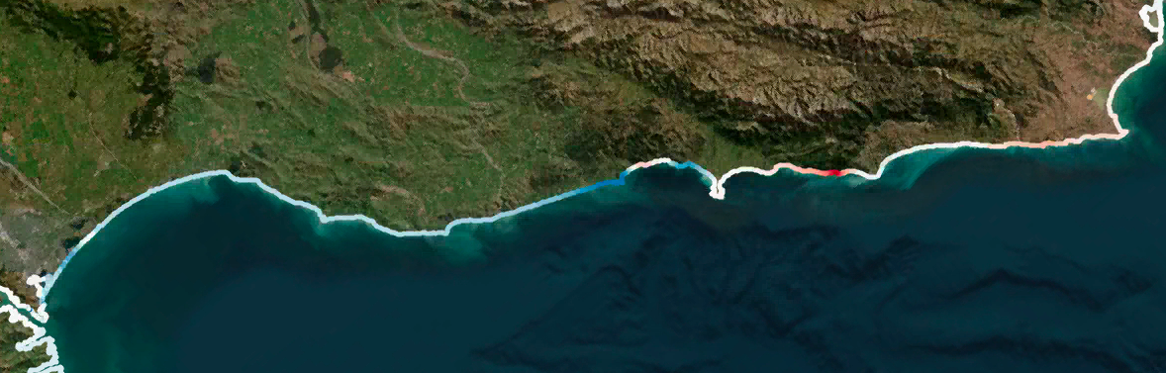
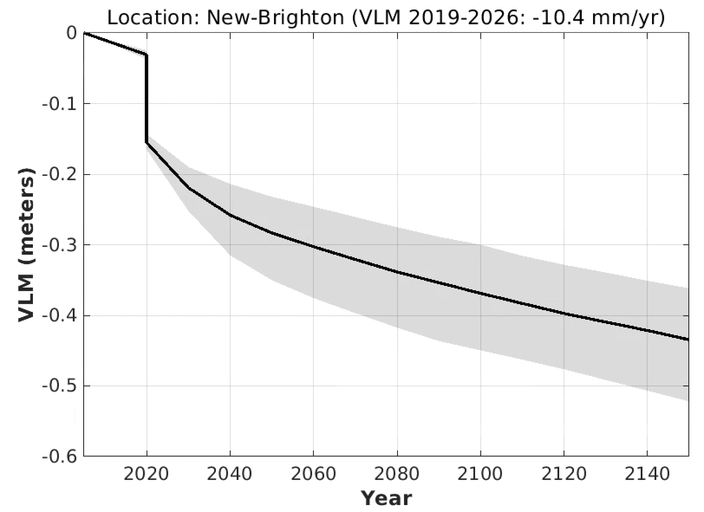
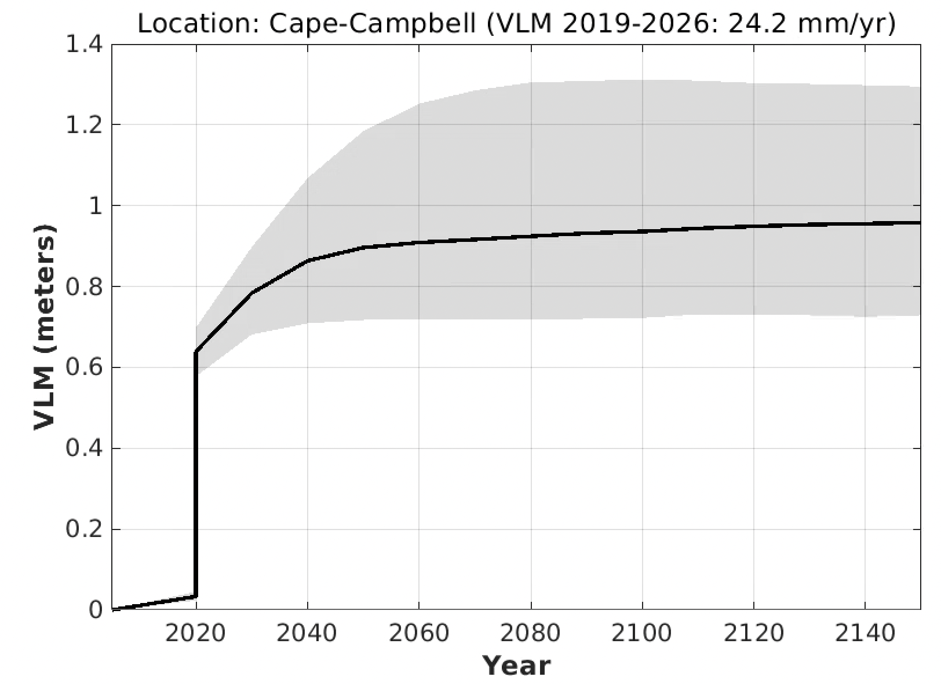
VLM rate estimates: Fusing interseismic rates with current rates, EQ offsets, post-seismic and building loading
-0.3
0
1.25
2.5
Co-Seismic VLM (m)

Slide 17
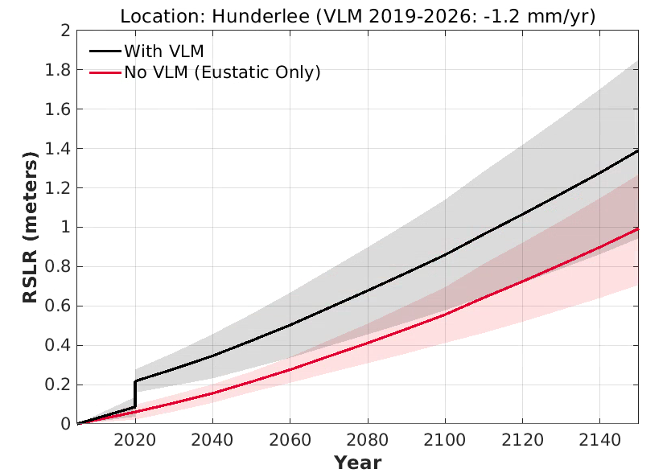
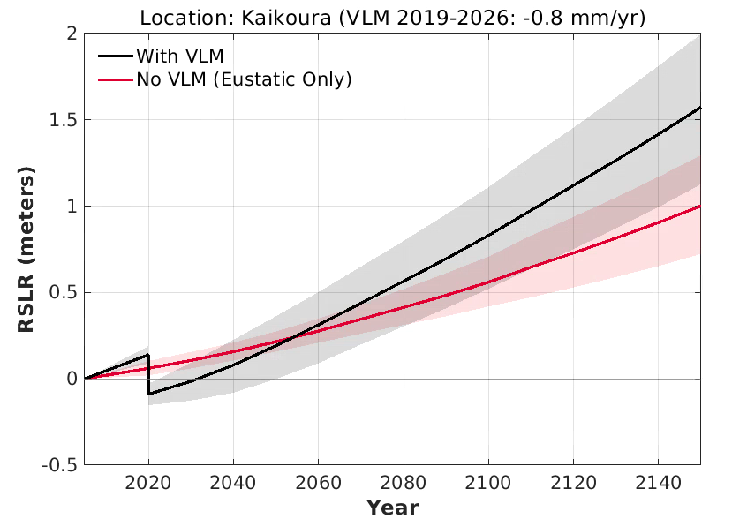
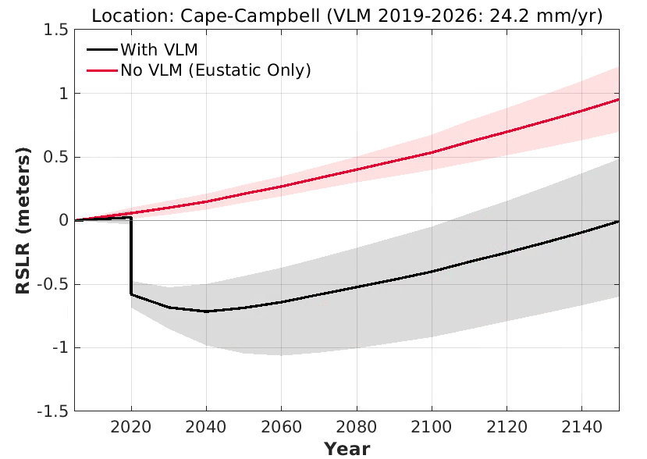
VLM rate estimates: Fusing interseismic rates with current rates, EQ offsets, post-seismic and building loading
-0.3
0
1.25
2.5
Co-Seismic VLM (m)

Slide 18
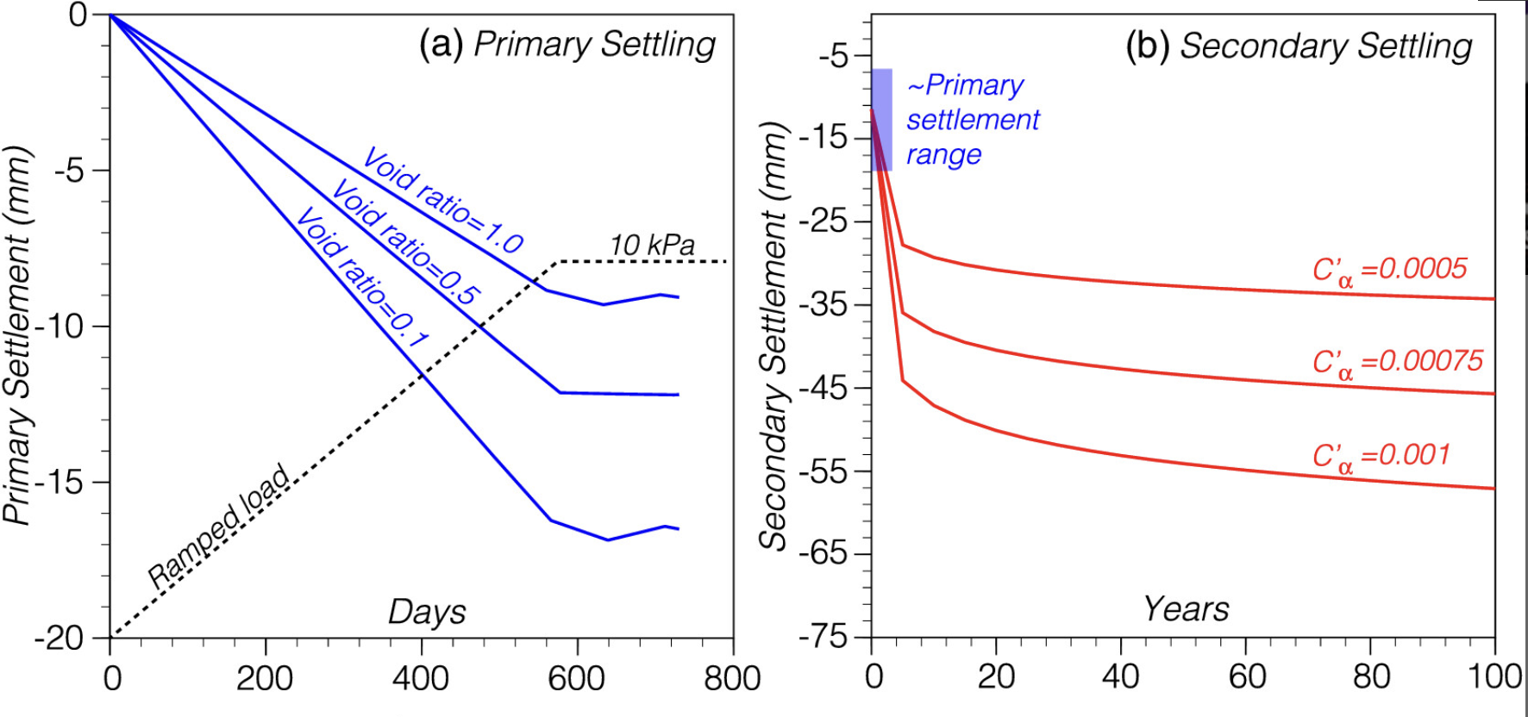
VLM rate estimates: Fusing interseismic rates with current rates, EQ offsets, post-seismic and building loading
Ground Cover | Slope angle | Classification
Urban | < 10 | Settlement/heave
Urban | > 10 | Urban Landslide
Bare ground/rock | > 10 | Landslide
Rural (forest, scrub, crop) | > 10 | Landslide/Phase bias
Rural (forest, scrub, crop) | < 10 | Phase-bias
Following construction, buildings experience subsidence due to soil compaction and consolidation with the highest rates of subsidence occurring within the first few years after construction but may have long lived transients (e.g. Parsons 2021).
Using landcover and terrain classifiers, we identify anomalously high local VLM and link it to a likely driver.

Slide 19
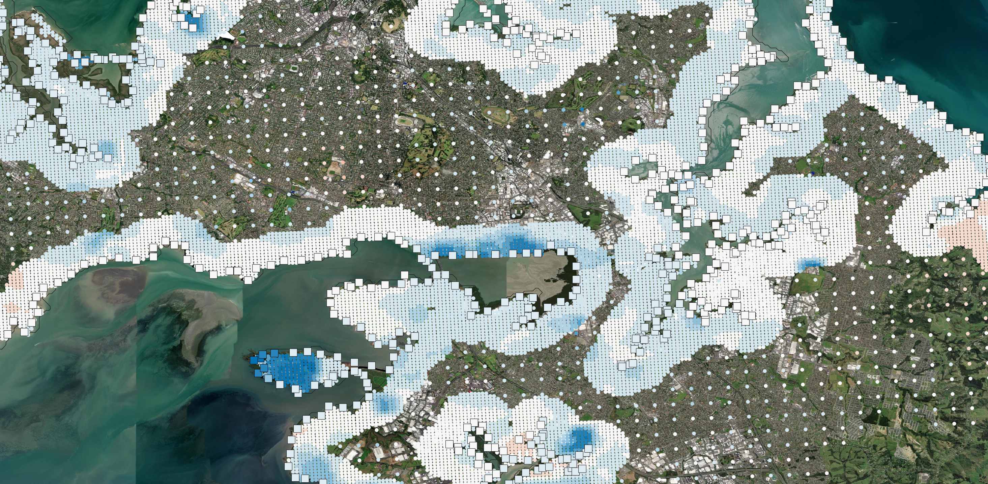
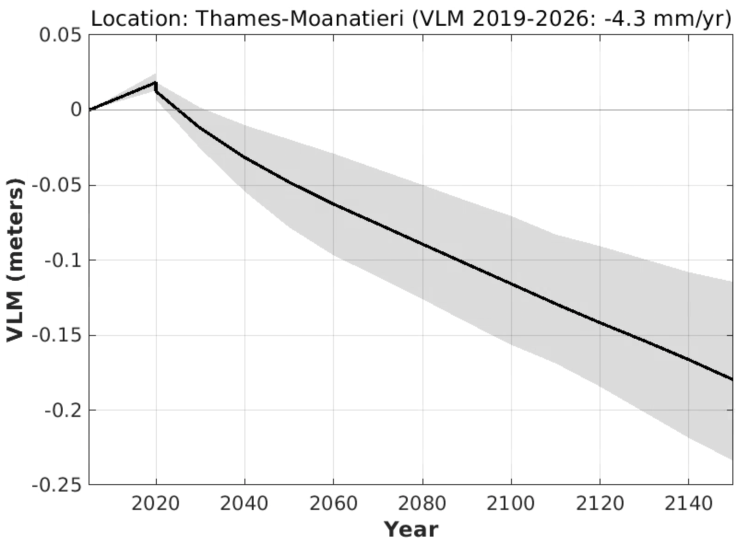
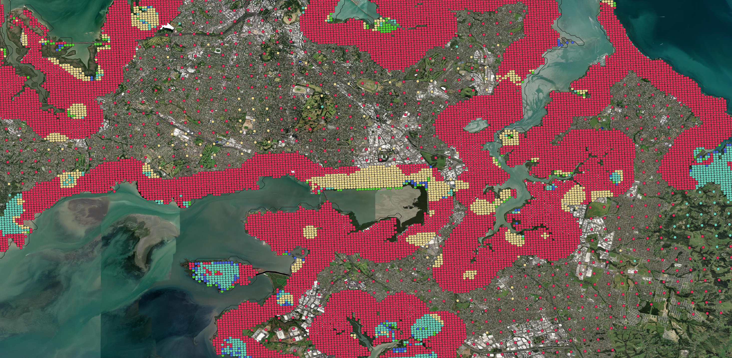
VLM rate estimates: Fusing interseismic rates with current rates, EQ offsets, post-seismic and building loading
Ground Cover | Slope angle | Classification
Urban | < 10 | Settlement/heave
Urban | > 10 | Urban Landslide
Bare ground/rock | > 10 | Landslide
Rural (forest, scrub, crop) | > 10 | Landslide/Phase bias
Rural (forest, scrub, crop) | < 10 | Phase-bias
For urban loading, we use a beta distribution peaking at 2030 (highest likelihood) but with a long tail sampling out to 2100 to incorporate extreme cases which we apply to points with anomalous VLM values which lie within urban areas

Slide 20
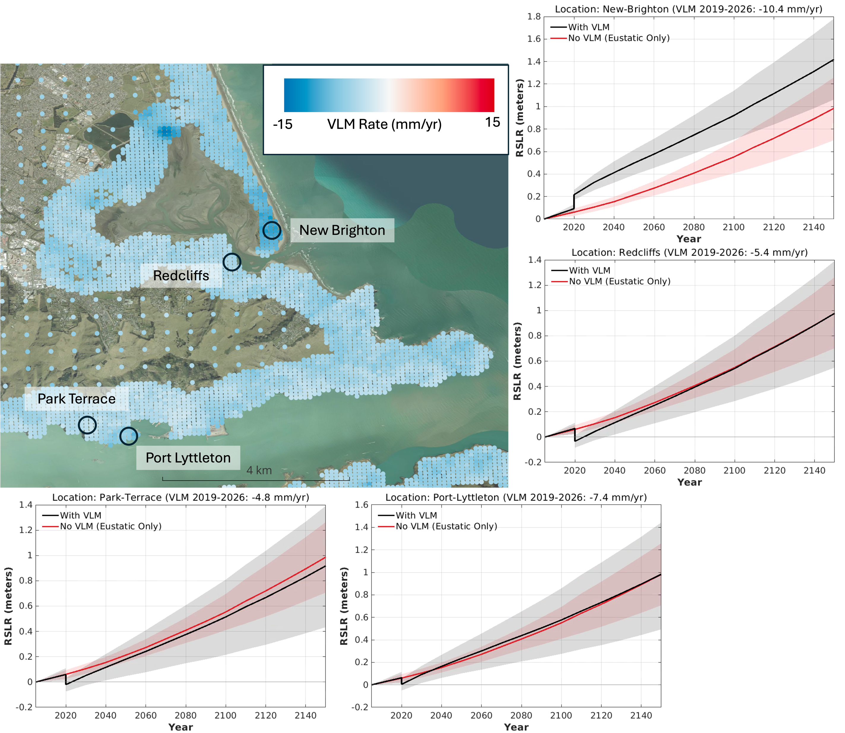
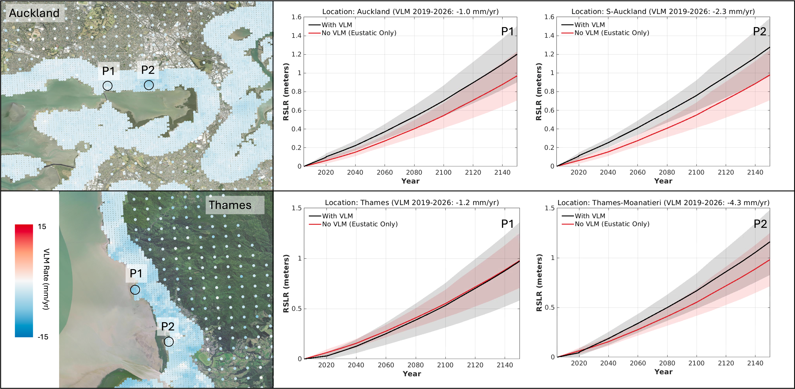
VLM rate estimates: Fusing interseismic rates with current rates, EQ offsets, post-seismic and building loading
The effect of the buildings on RSLR causes a short term bulge in the projections where we see the effect of the increased rate in RSLR over the next 20-30 years.
In conventional approaches, by 2150, this would potentially add ~100’s mm of additional VLM compared with 30-50 mm derived here.

Slide 21

Conclusions
We’ve developed and implemented a VLM projection framework to help incorporate non-linear VLM into future RSLR projections.
This approach avoids linearly projecting VLM into the future in areas where we know the underlying process is unlikely to continue into the future beyond a few decades.
The adaptive ensemble approach easily allows for probability distributions to be modified and refined as new observations become available and can be tailored for different regional geologies and tectonic settings.
For New Zealand, the most significant updates to the projections are found across the upper east coast of the South Island (Christchurch and north) where the impacts of recent earthquakes dominate the VLM projections.

