Slide 1
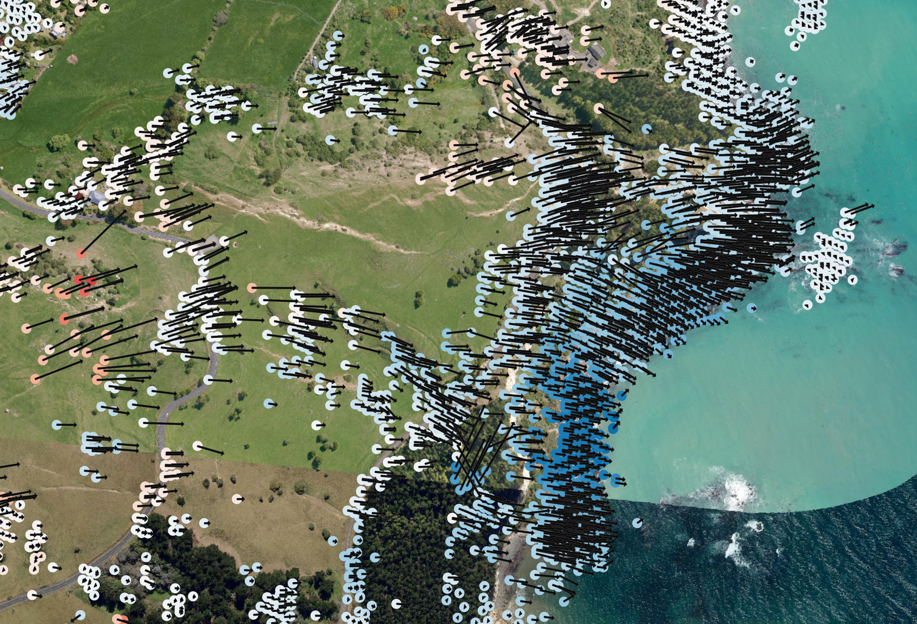
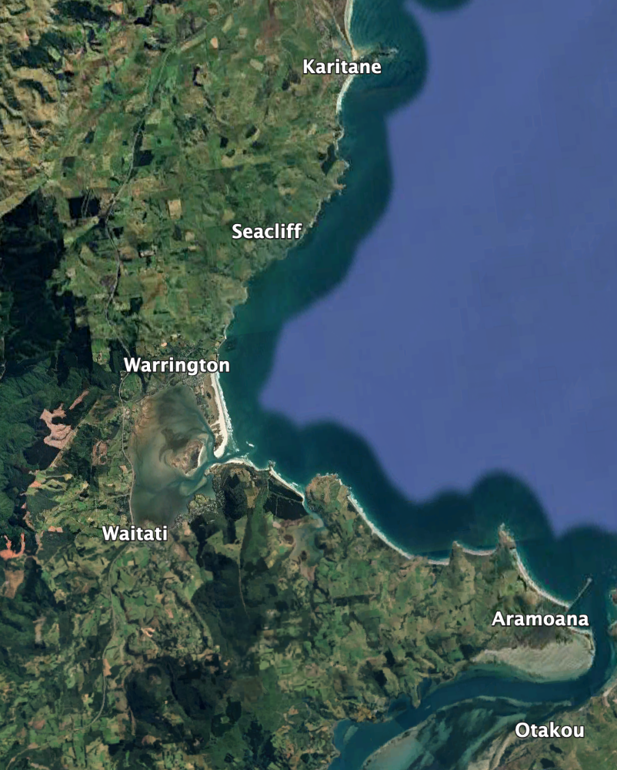
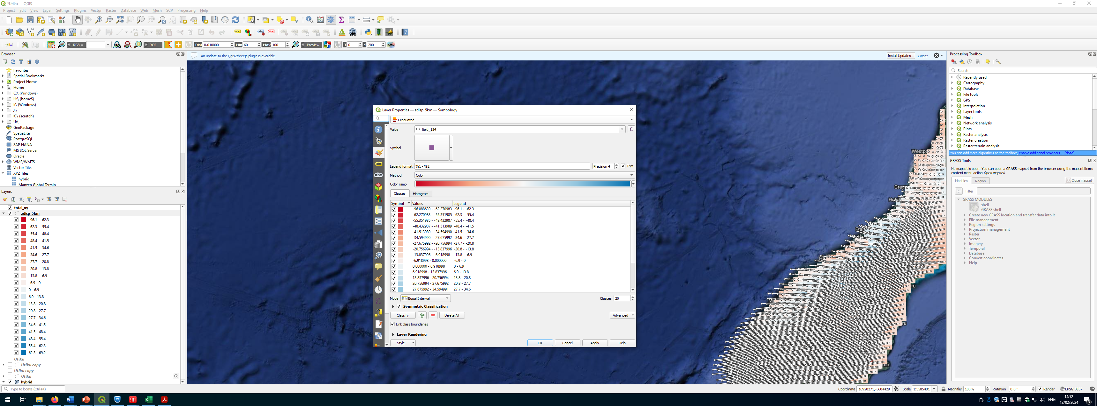
Rail
-30
-30
Vertical displacement (mm/yr)
Large rotational landslides affecting rail corridor north of Seacliff, Otago. Toe of the landslide is uplifted at ~ 30 mm/yr with lateral rates of > 50 mm/yr

Slide 2
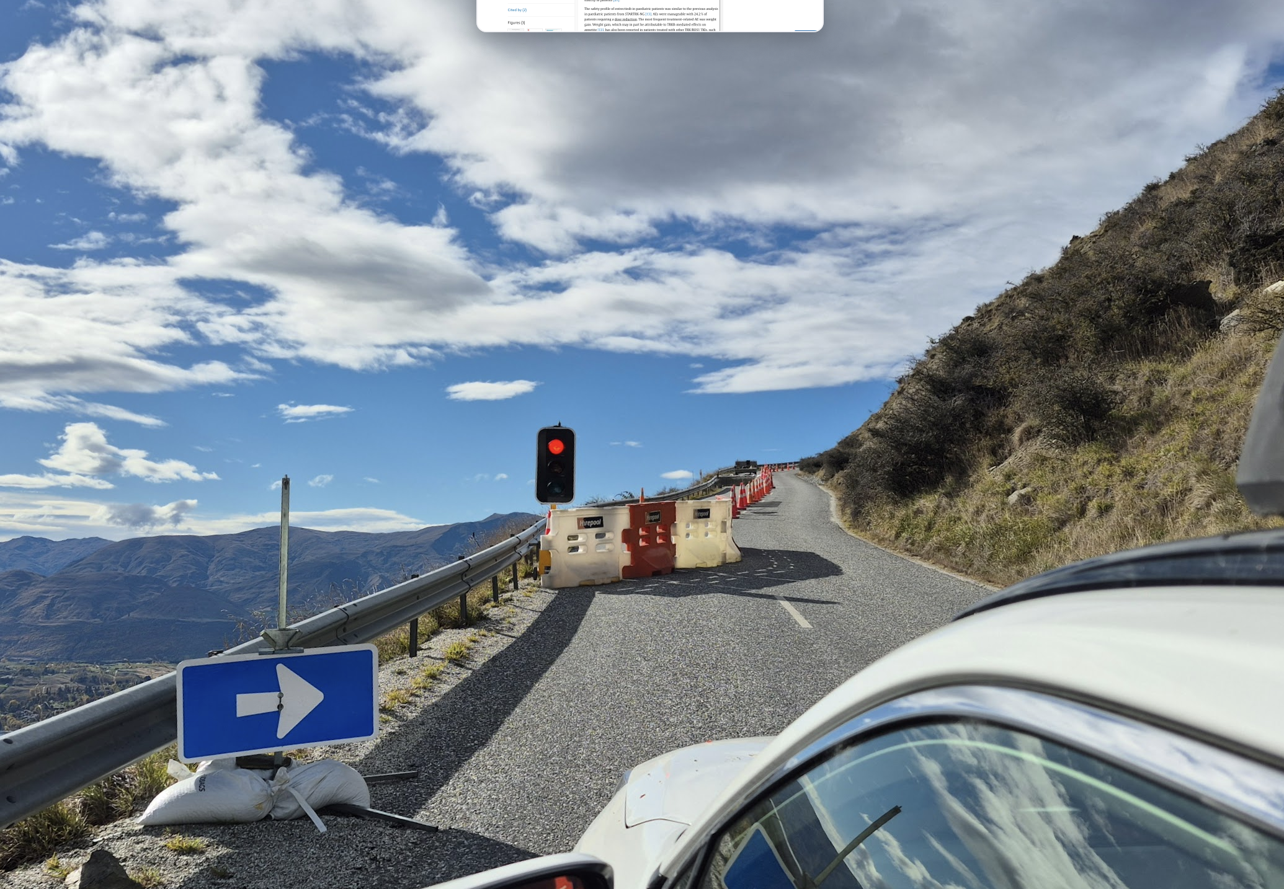
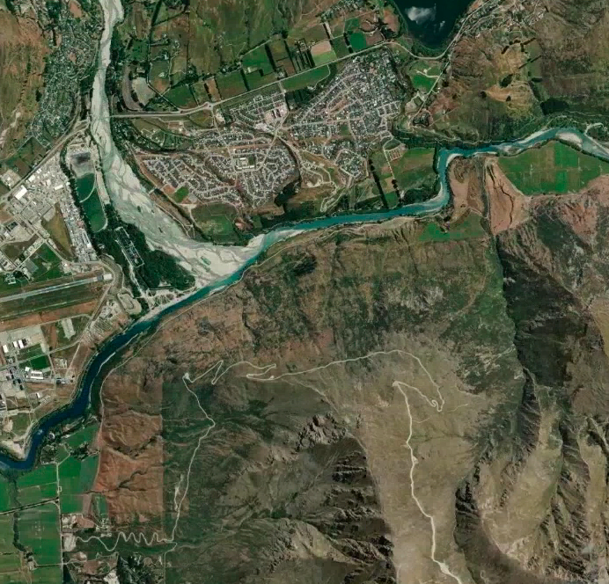
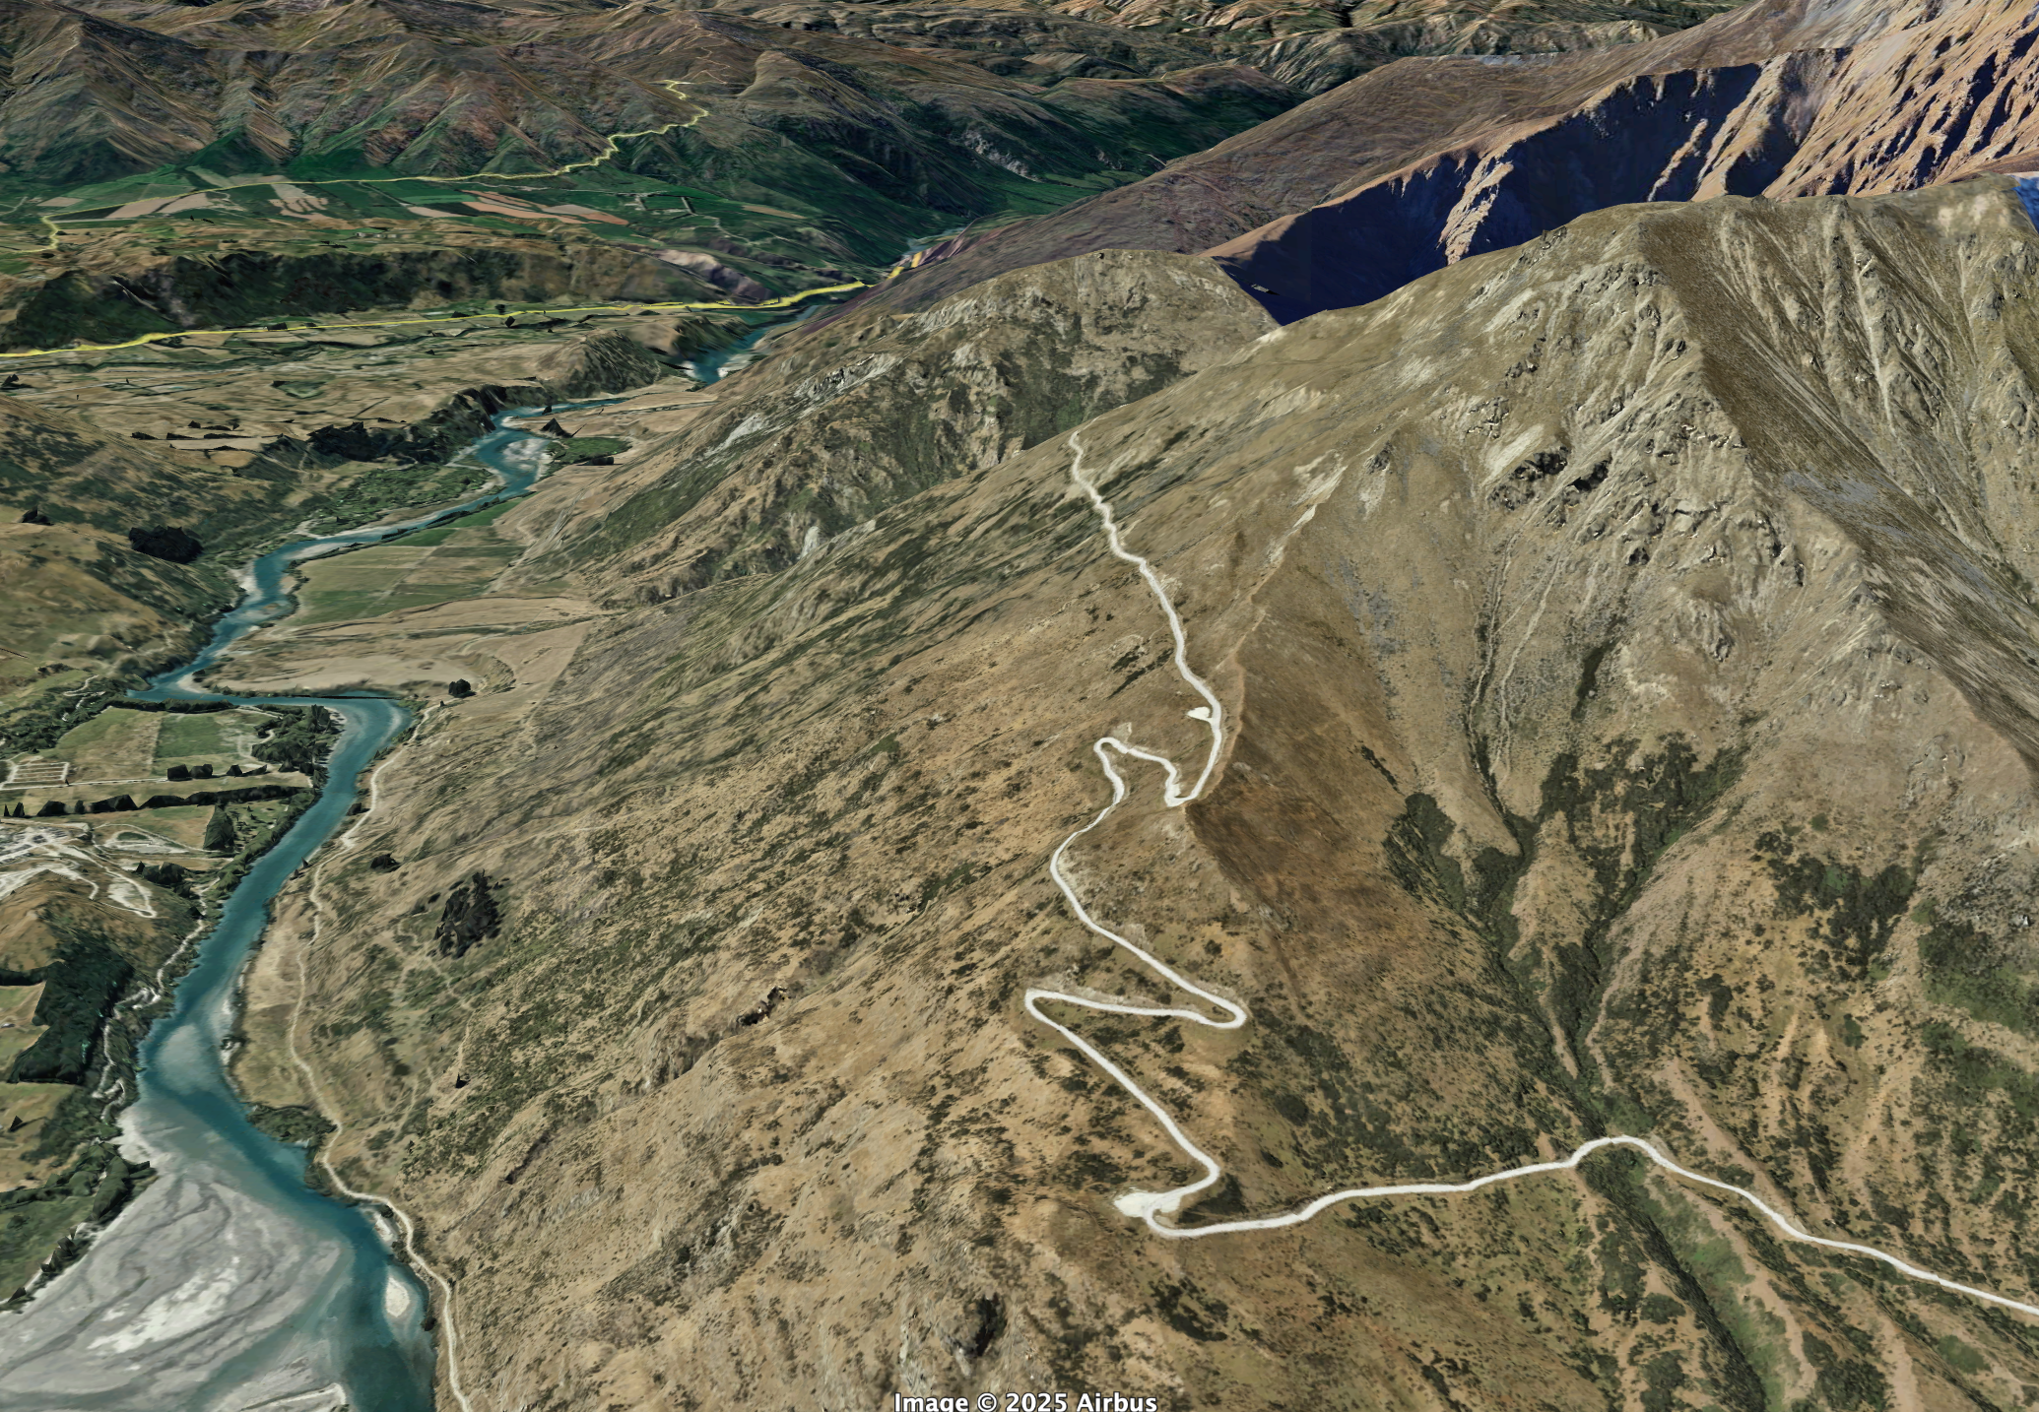
3D displacements: Remarkables ski field access
Kawarau River
300 m ASL
Queenstown airport
1500 m ASL
Ski field access road

Slide 3
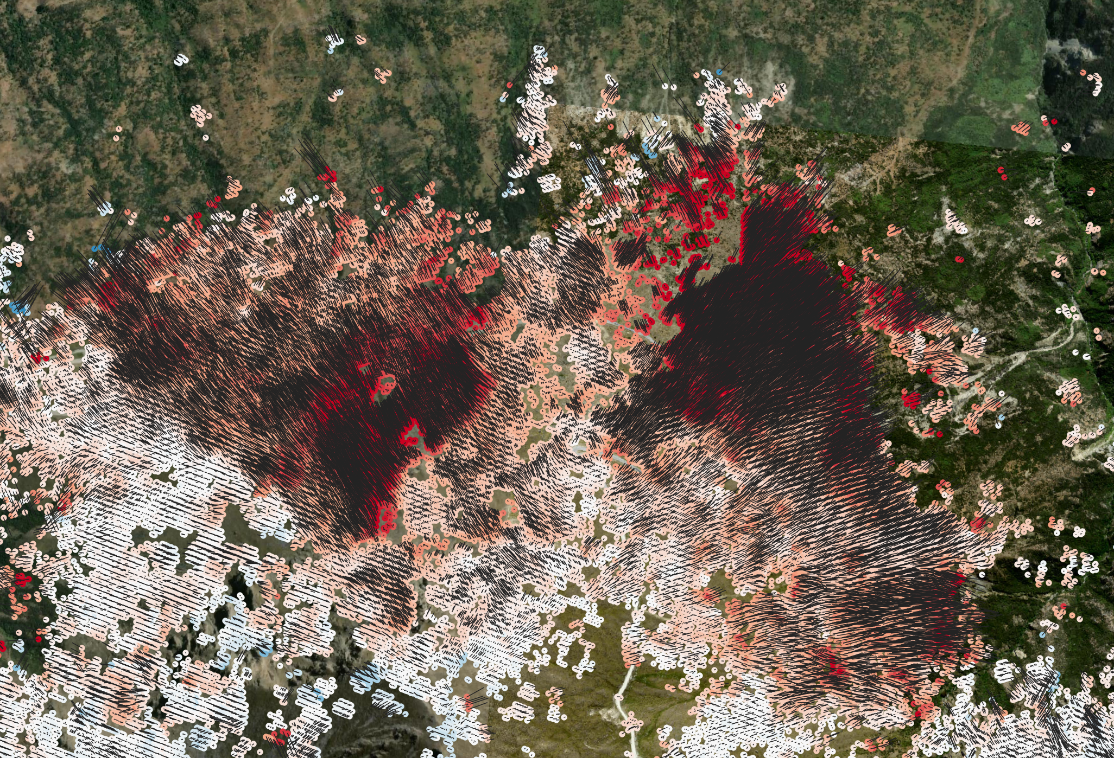
-50
0
50
Vertical Displacement rate (mm/yr)
Both vertical and horizontal components suggest the highest activity is within the landslide mass and away from the head scarp with peak vertical and horizontal velocities of ~50 and 60 mm/yr respectively

Slide 4
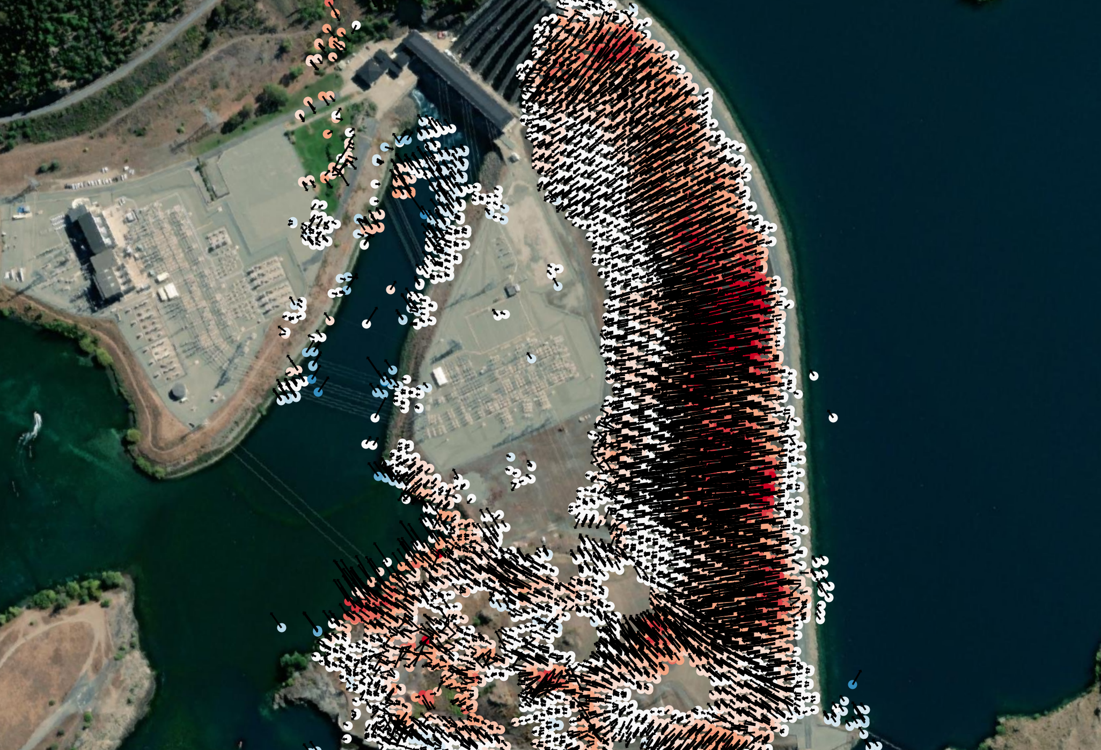
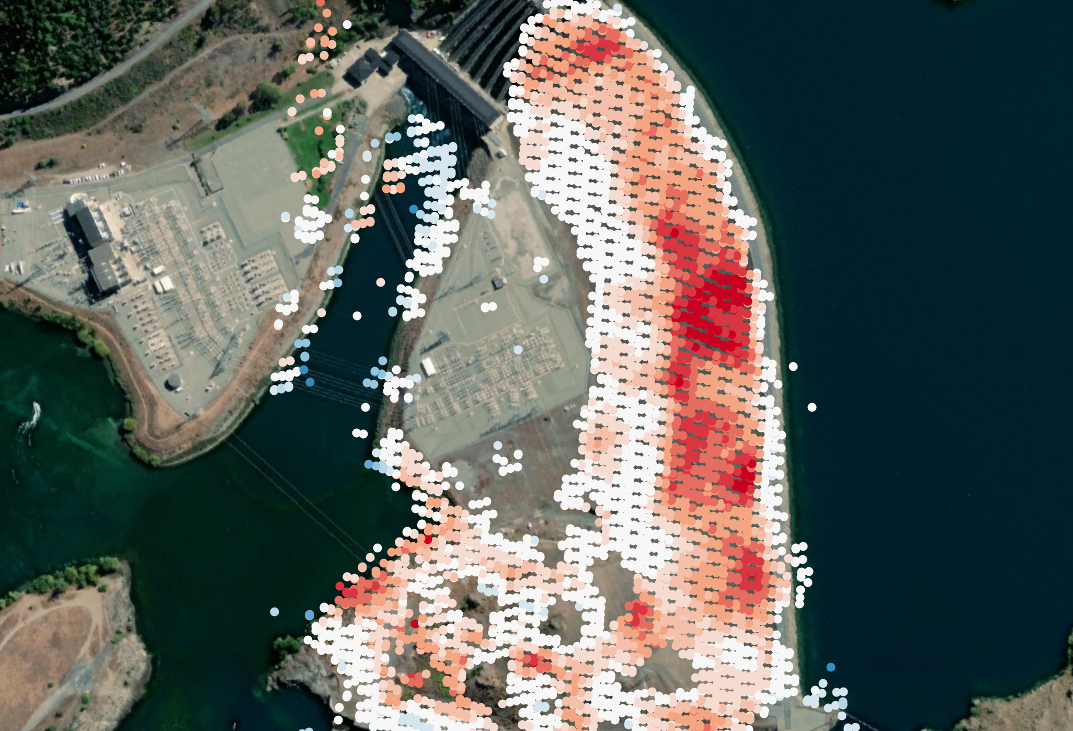
Benmore Dam located Waitaki Valley is largest earth dam in New Zealand.
At Benmore, data suggests horizontal and vertical movement of ~10-20 mm/yr between 2015 and 2025

