Slide 1
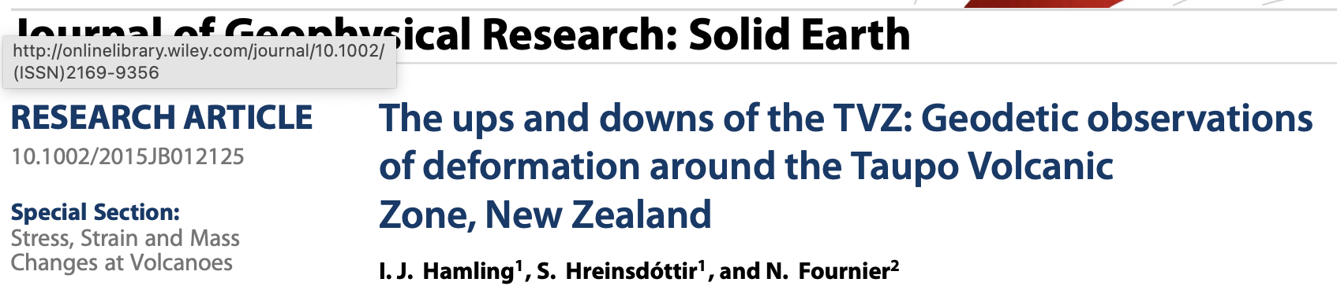
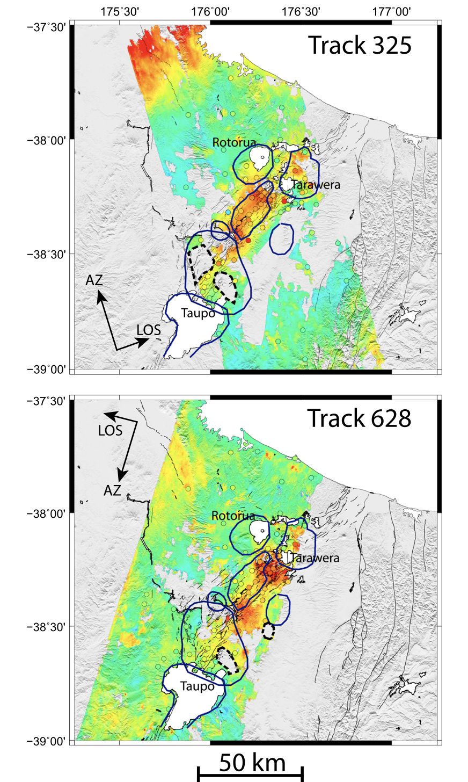
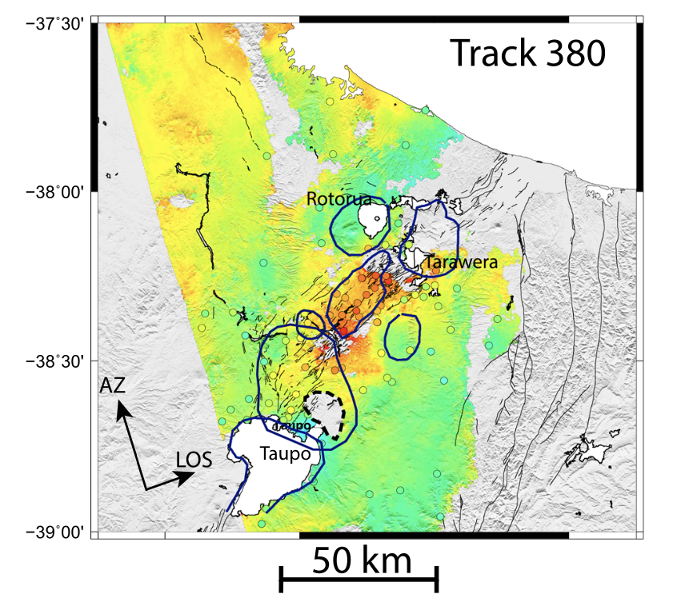
GPS data 1995-2014.5
ALOS between 2003 and 2011

Slide 2
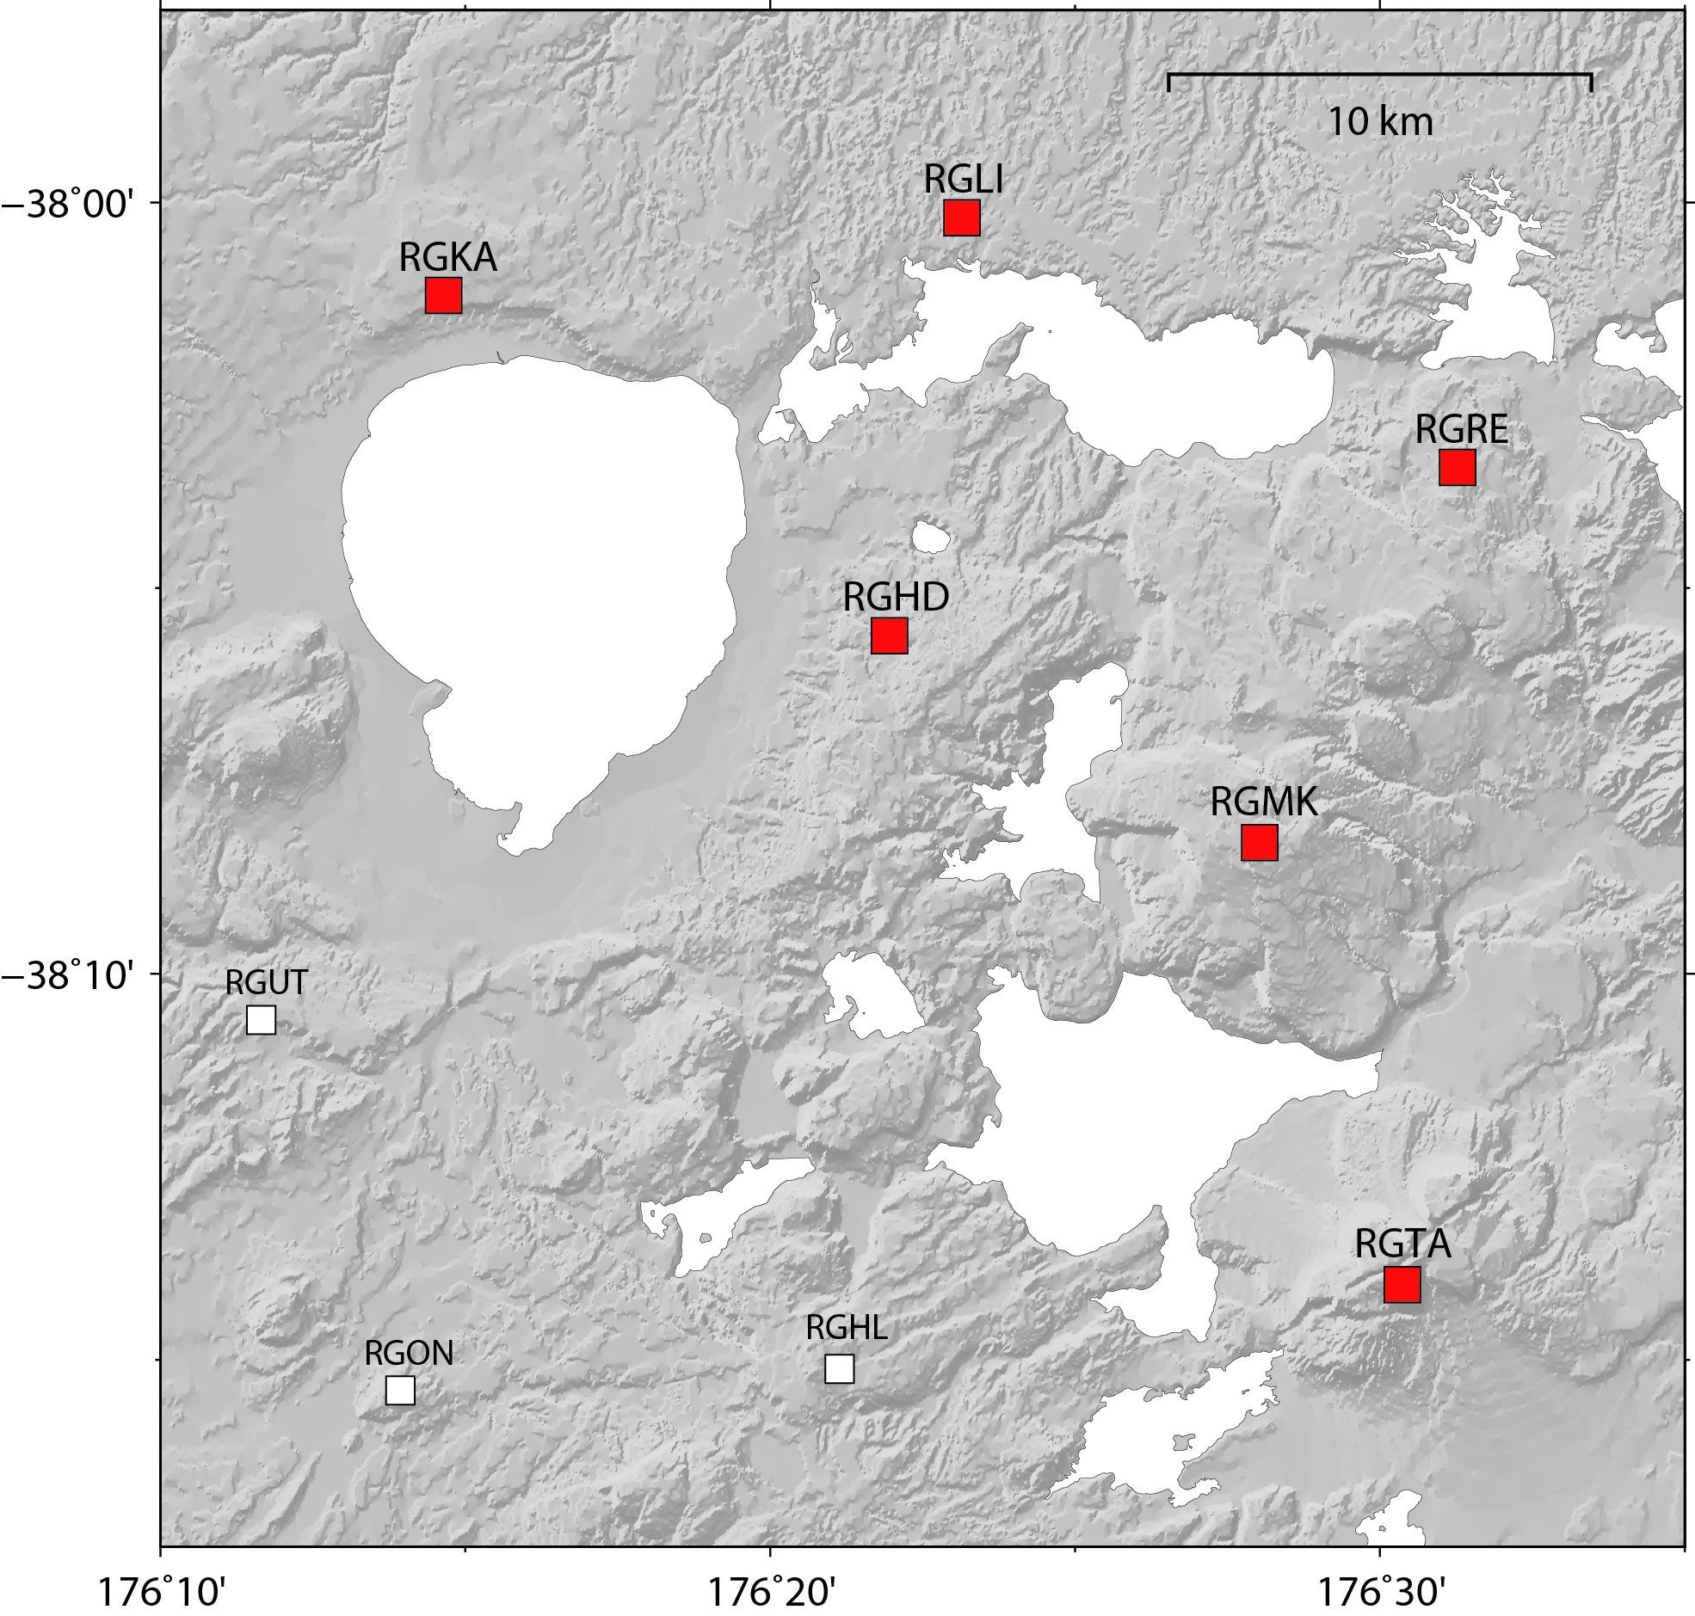
-4 mm/yr
-4 mm/yr
2014-2020
-5 mm/yr
-5 mm/yr
-20 mm/yr
Kapenga Caldera
-15 mm/yr
-17 mm/yr
-16 mm/yr

Slide 3
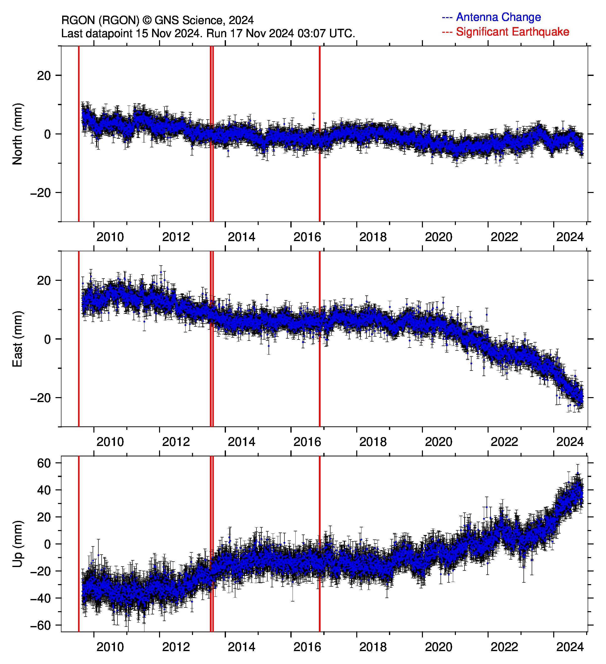
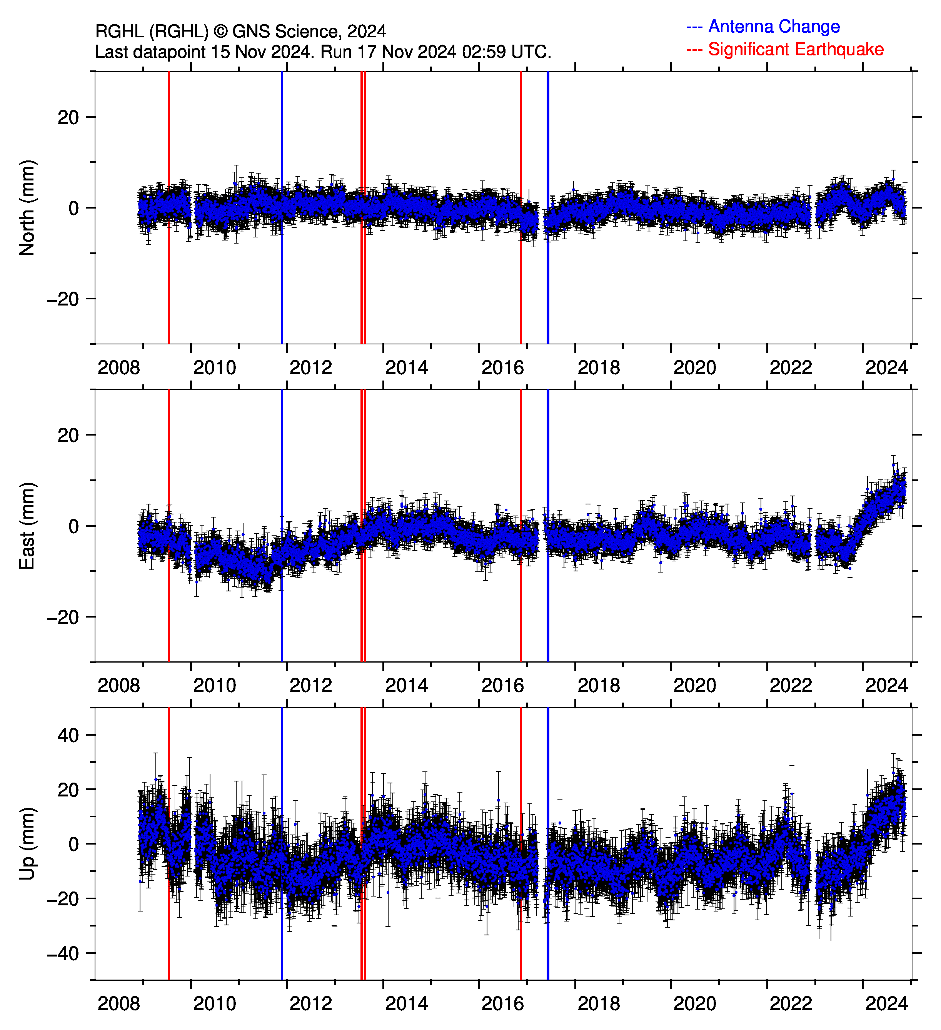

Slide 4
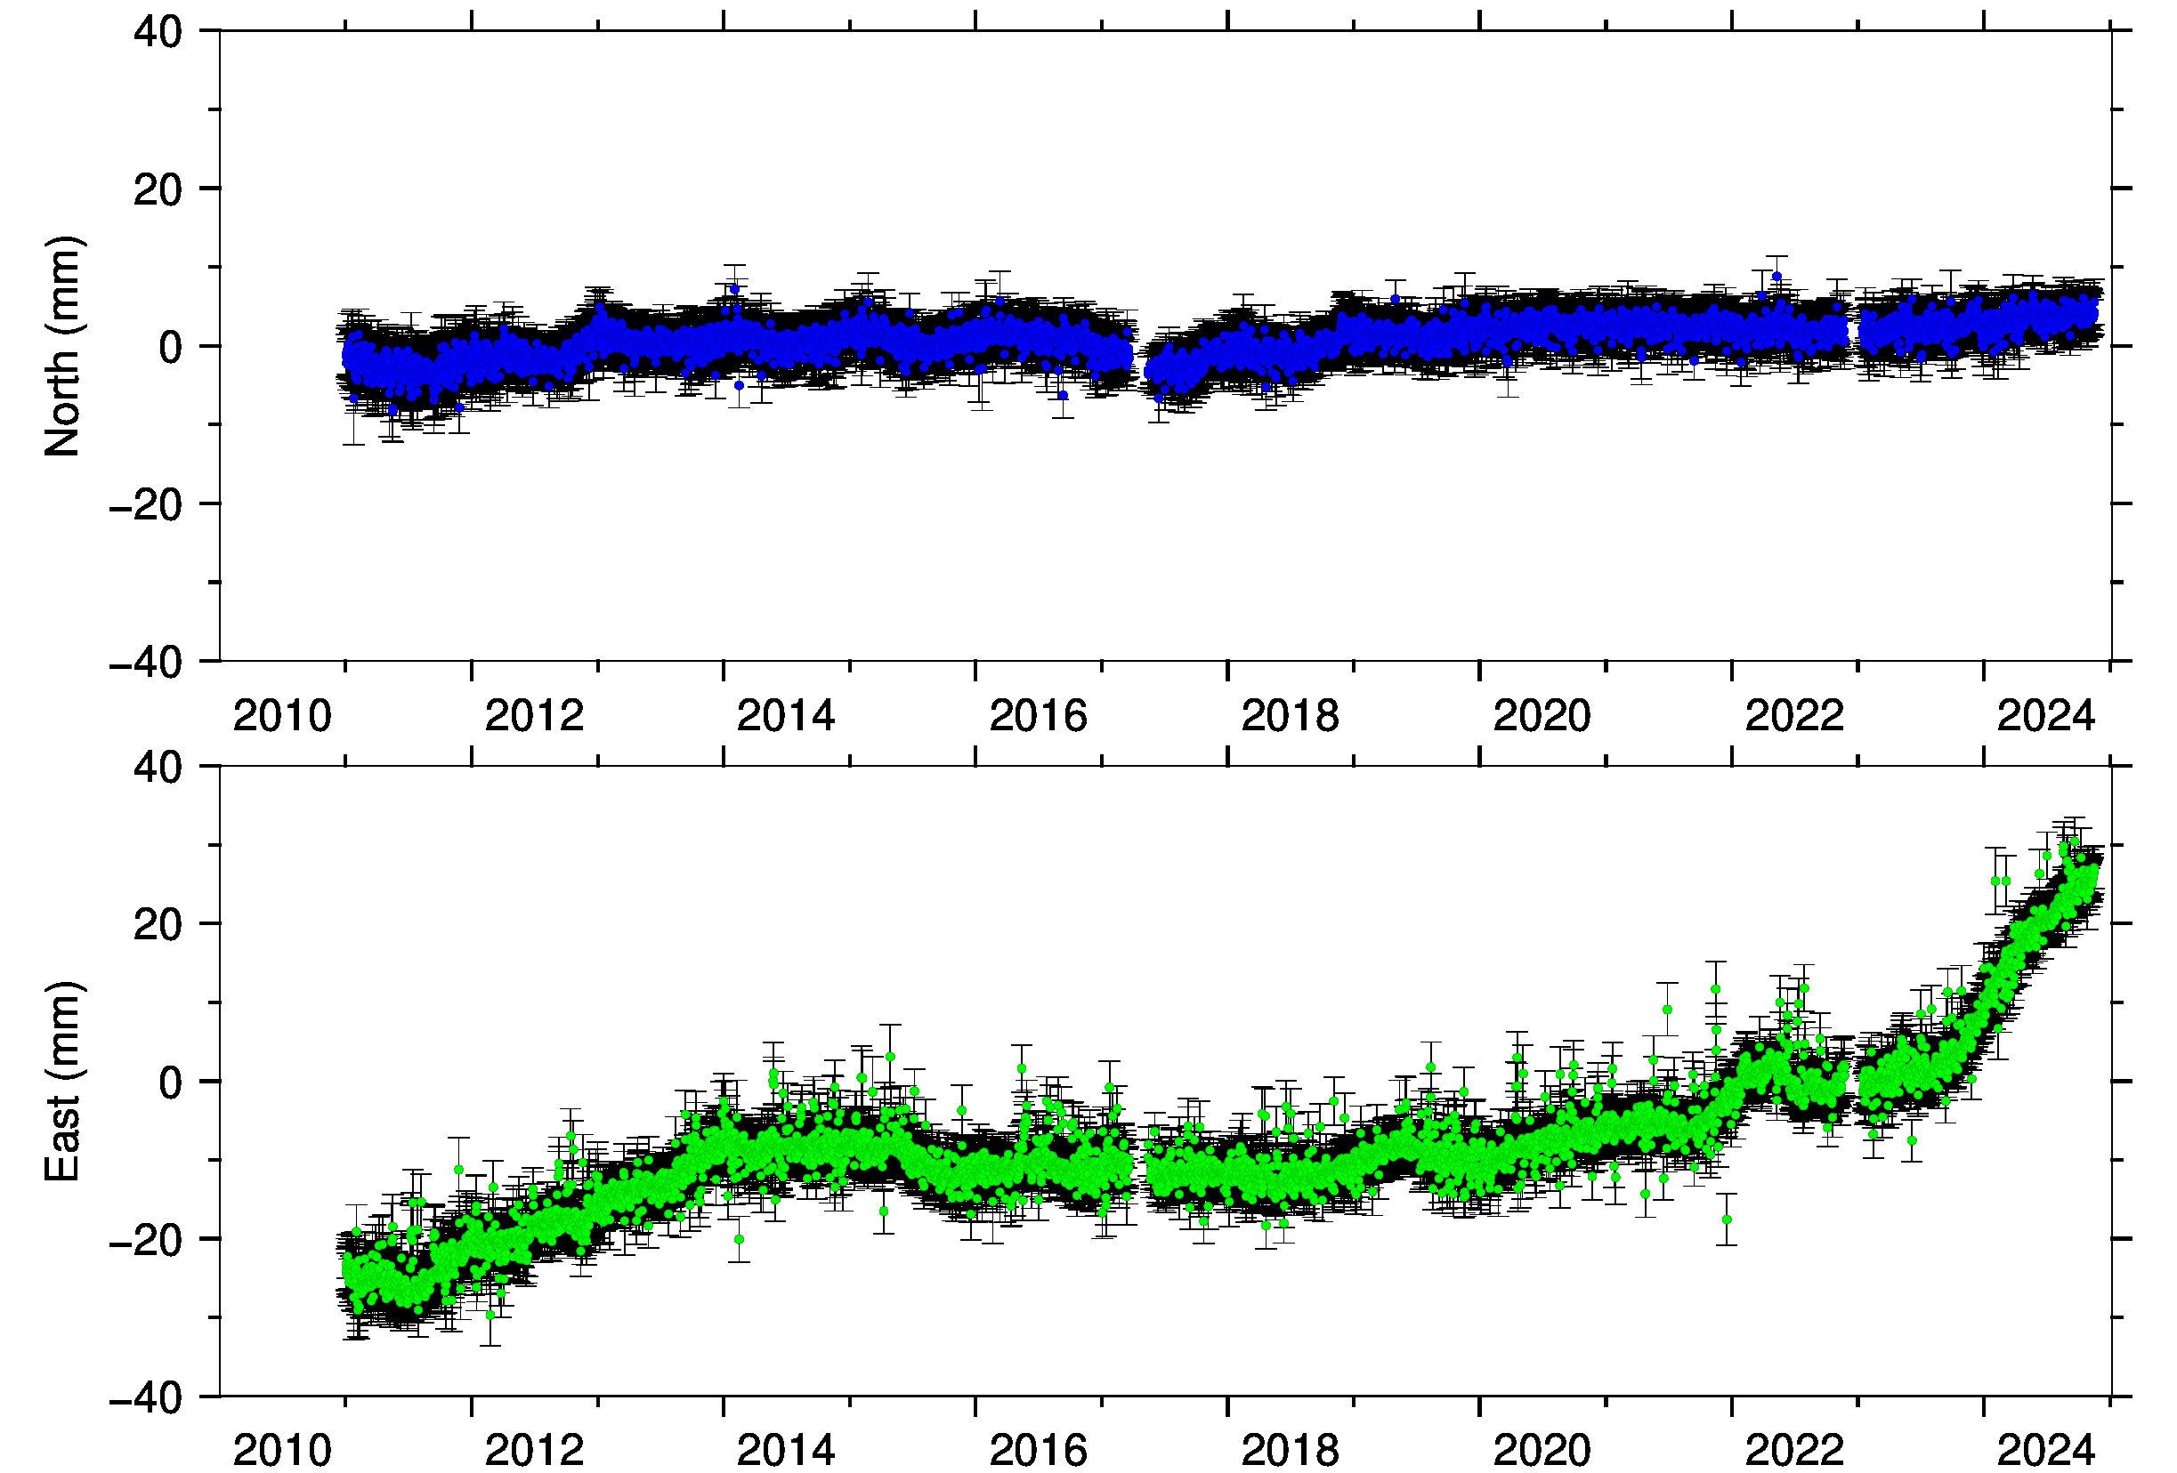
RGHL-RGON
NORTH
6 mm/yr
20 mm/yr
EAST
RGON
RGHL

Slide 5
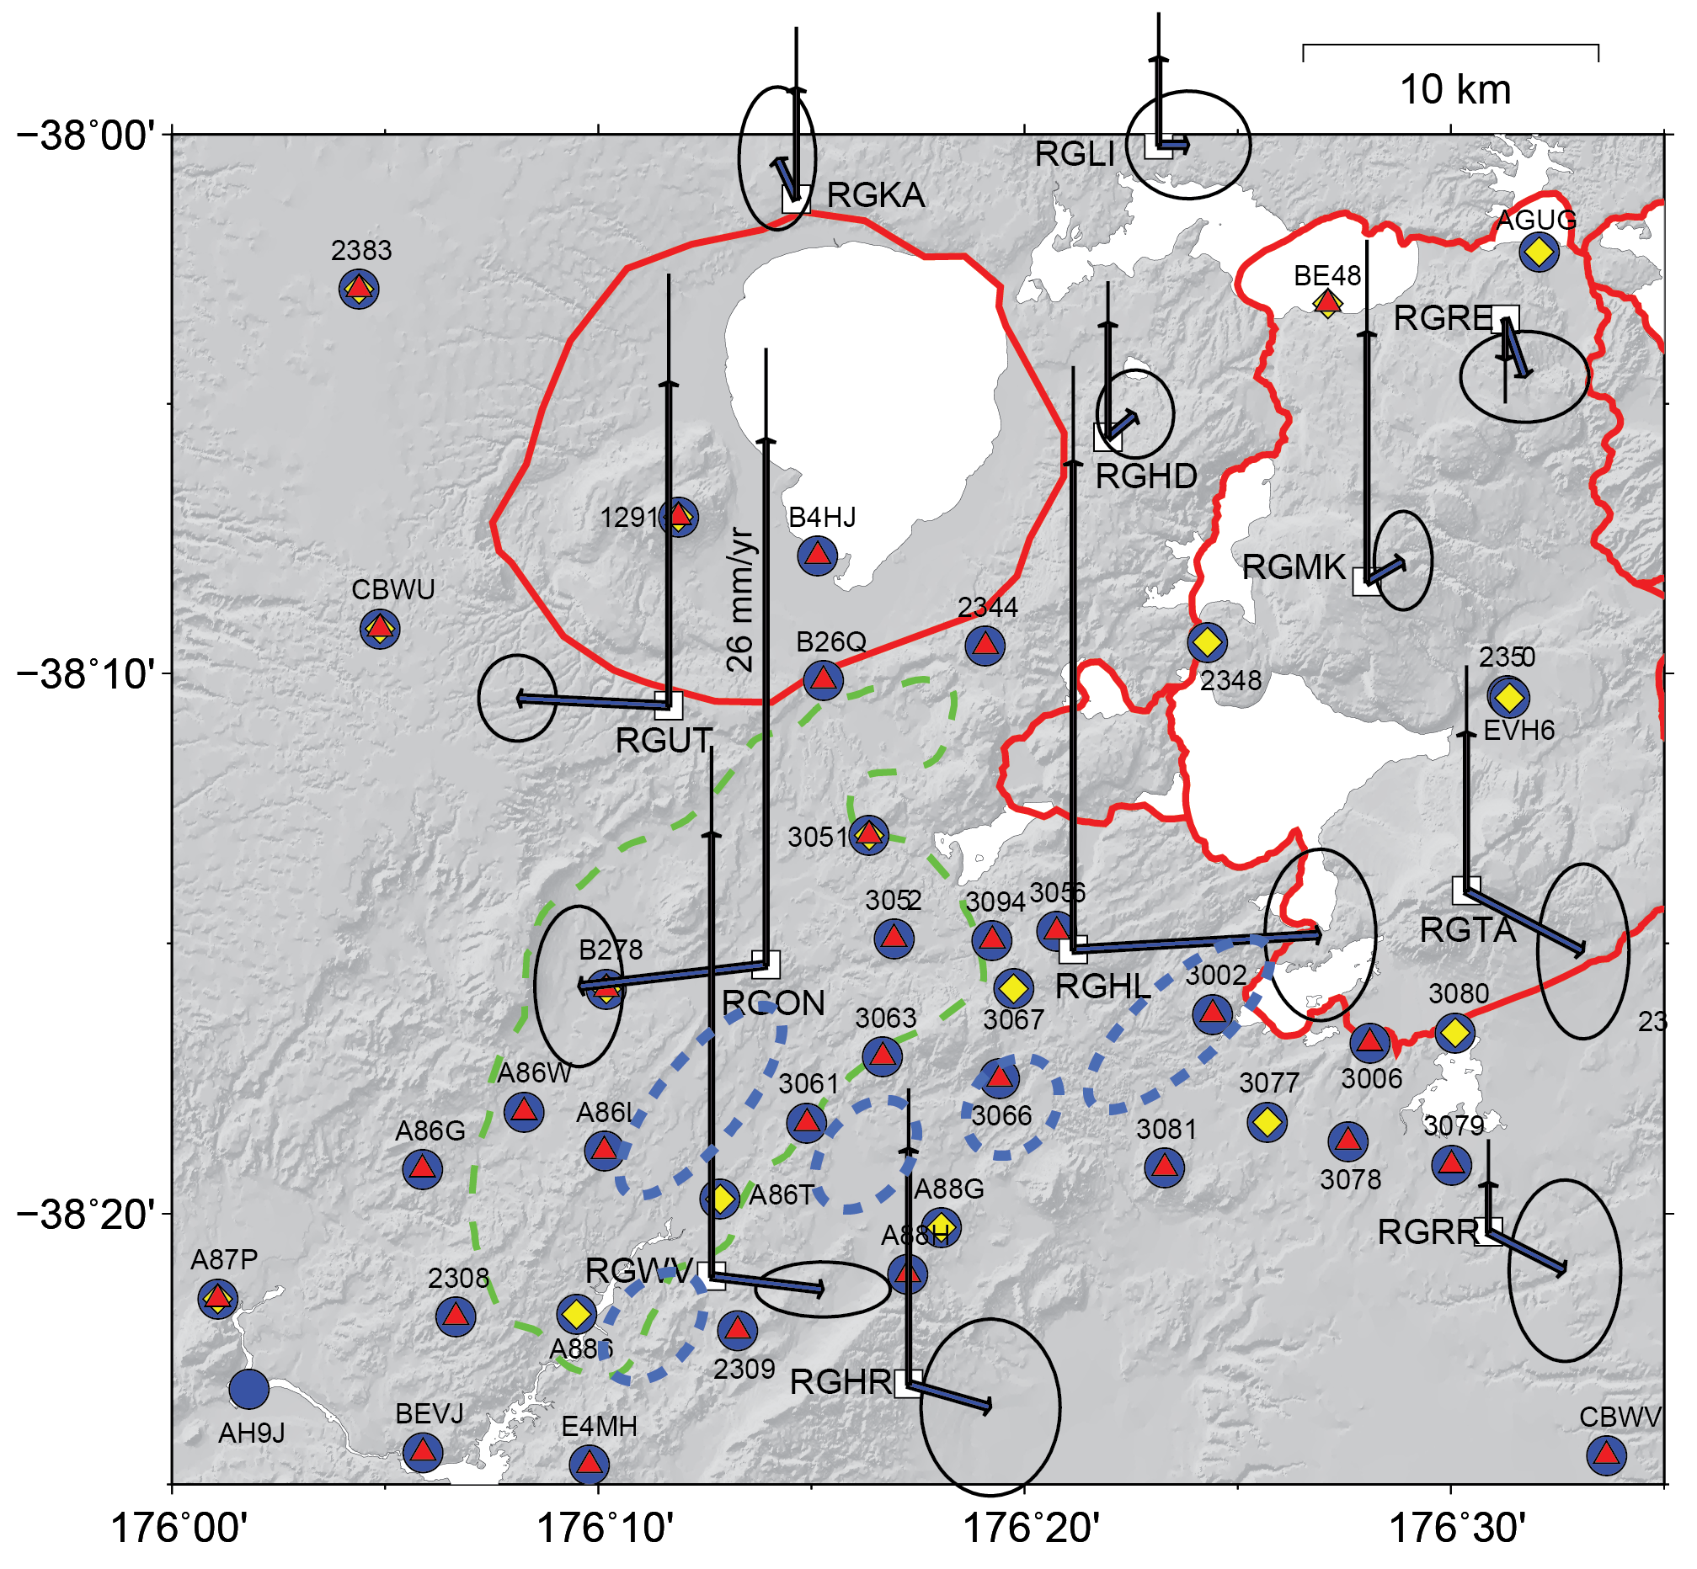
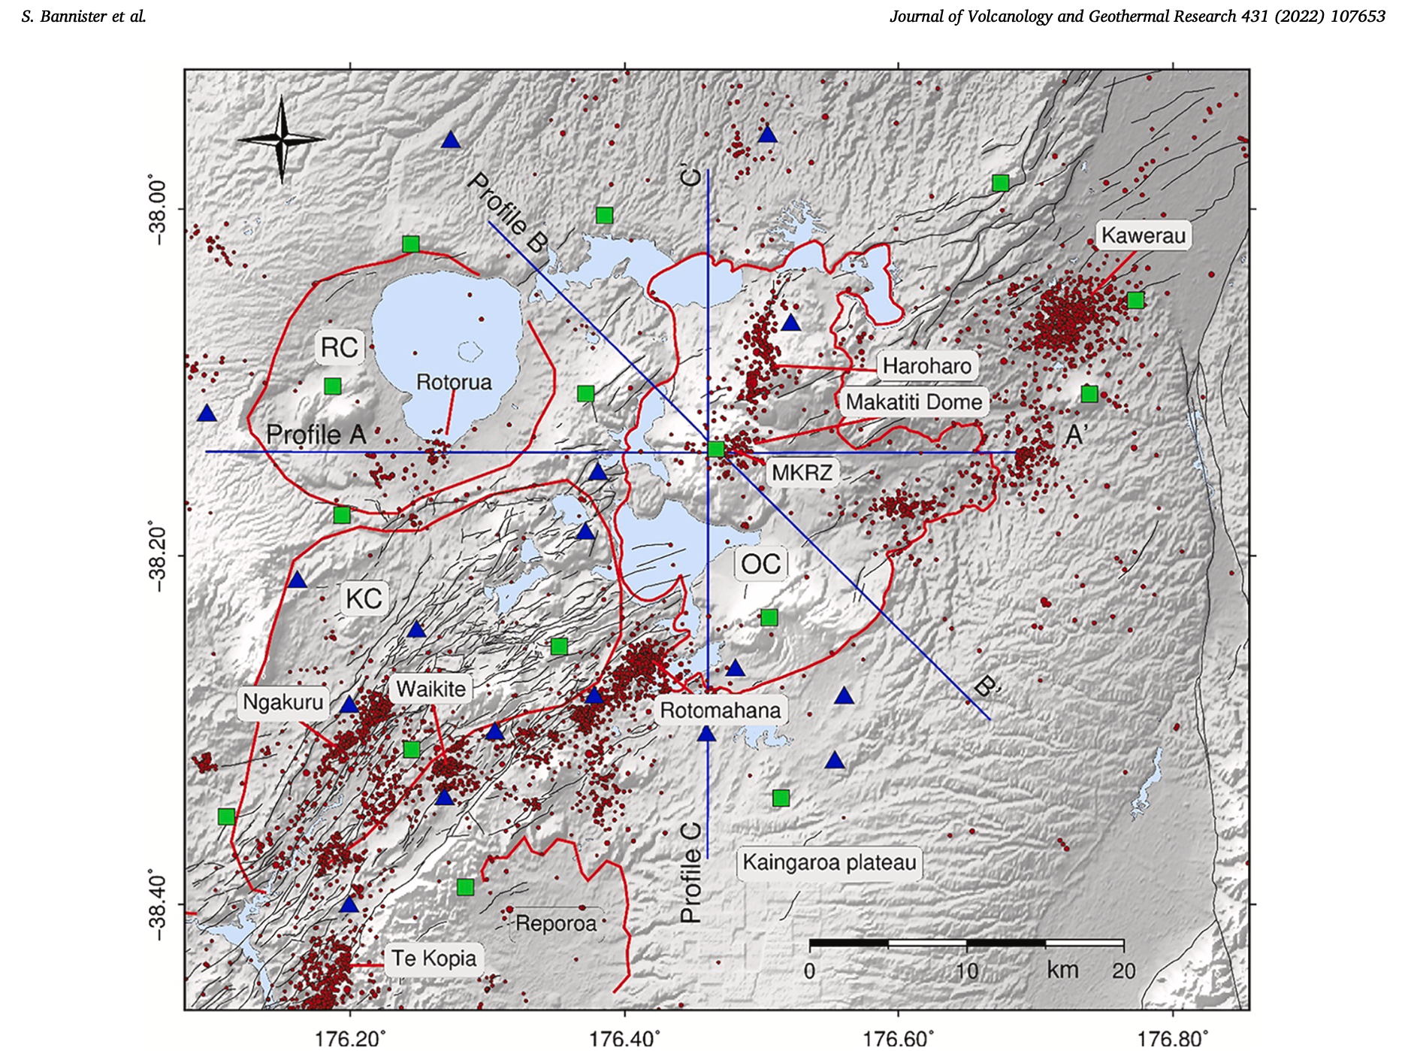
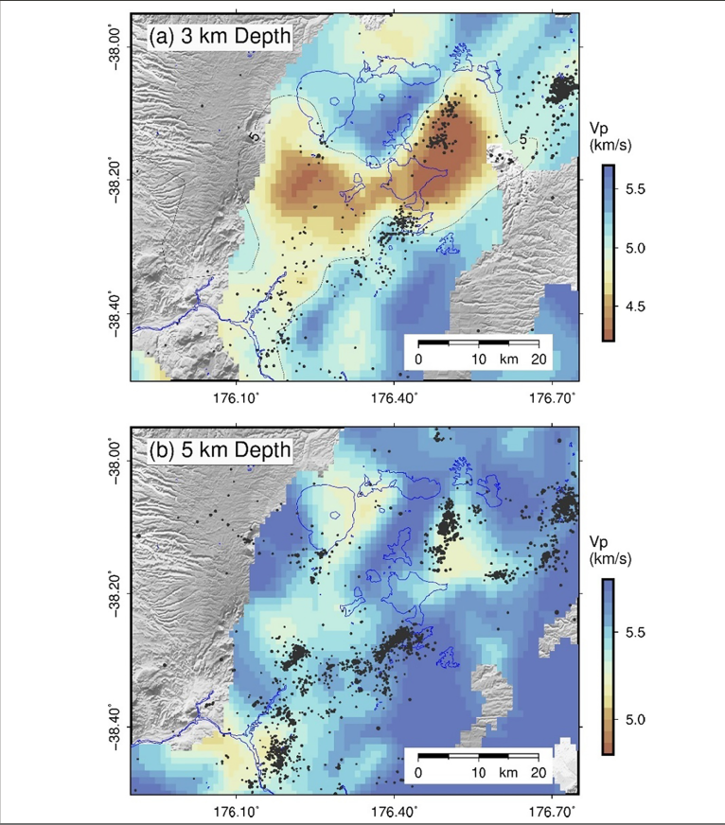
Kapenga Caldera

